Slide 1

Memento “Time Travel for the Web“ 101
http://mementoweb.org/
Memento has received funding from
The Library of Congress
Andrew W. Mellon Foundation
IIPC
1

Slide 2
Memento Makes Navigating the Web’s Past Easy
RFC 7089 (2013) Van de Sompel, H., Nelson, M.L., Sanderson, R.
HTTP Framework for Time-Based Access to Resource States - Memento
http://tools.ietf.org/html/rfc7089
2
Notes:
2

Slide 3
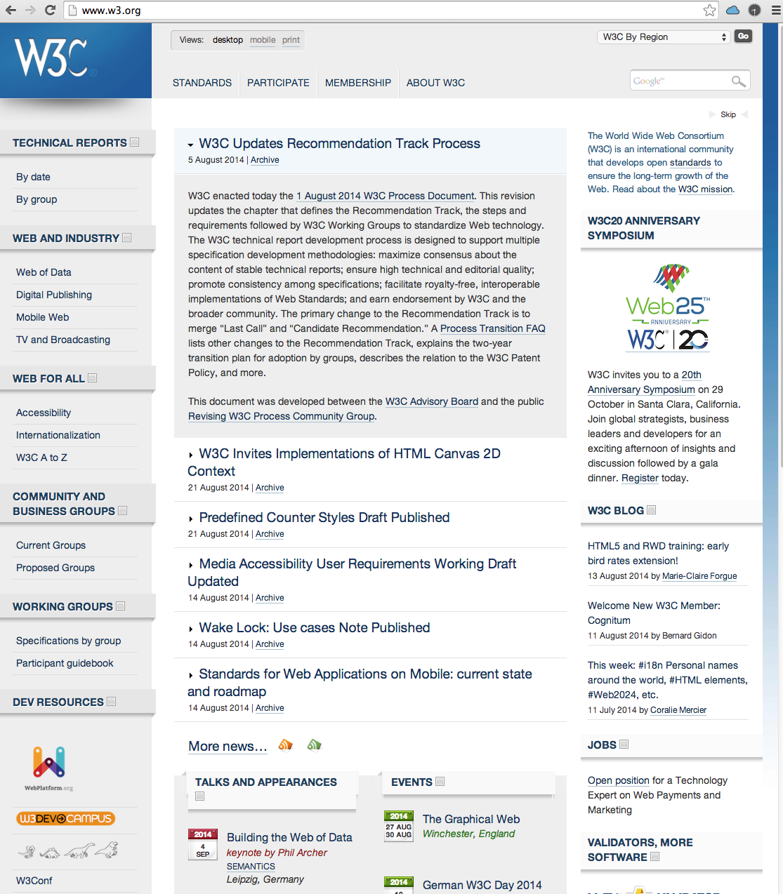
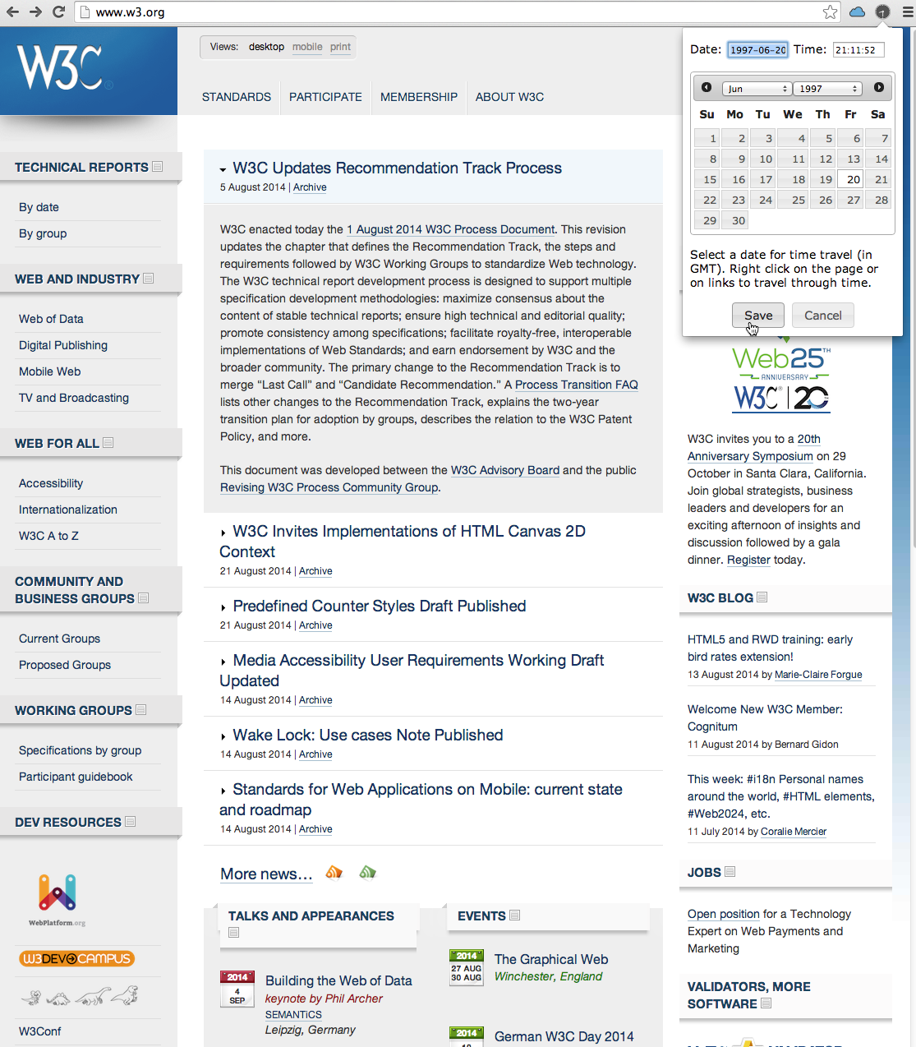
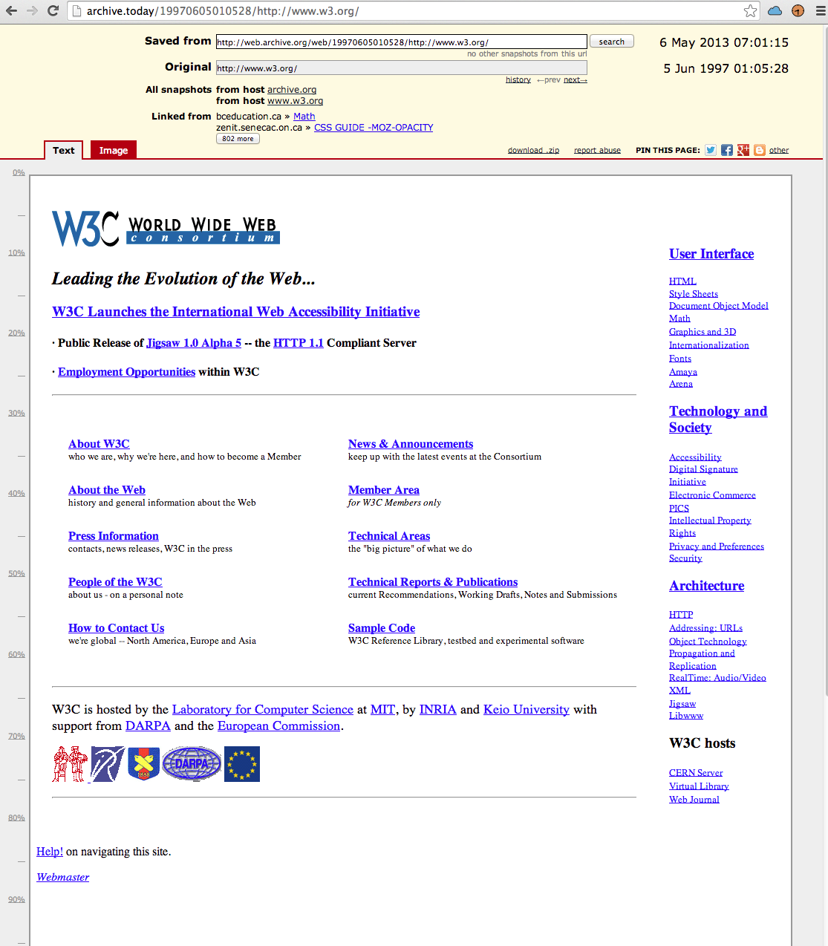
Memento: Access Versions via the Original URI and a Datetime
Select Date
June 20 1997
Today
June 5 1997
From archive.today
3

Slide 4
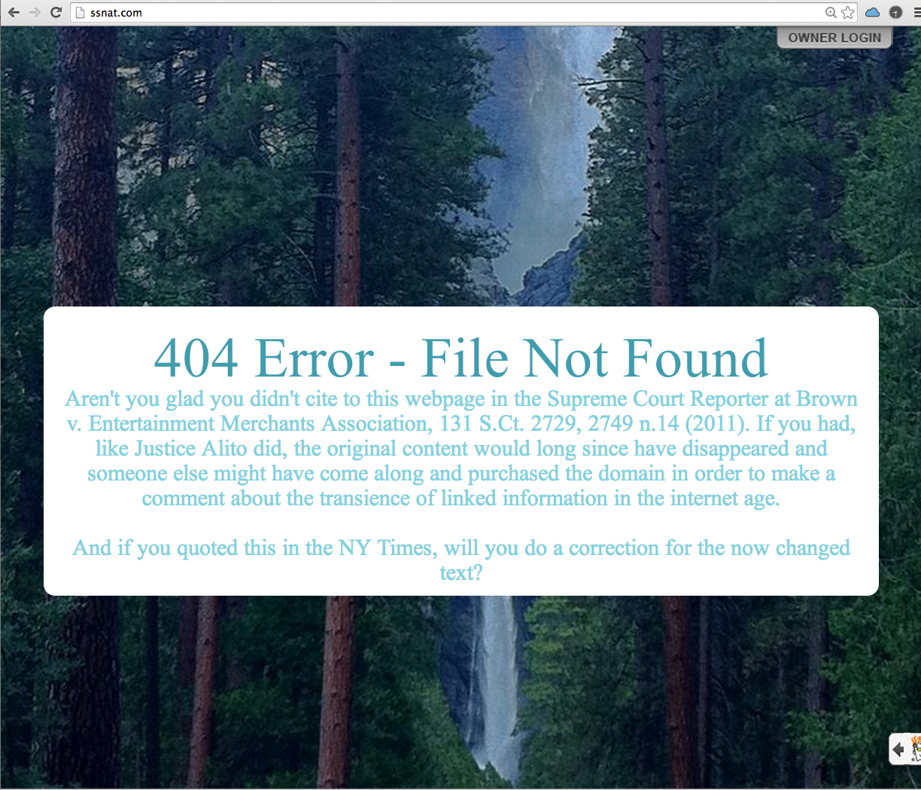
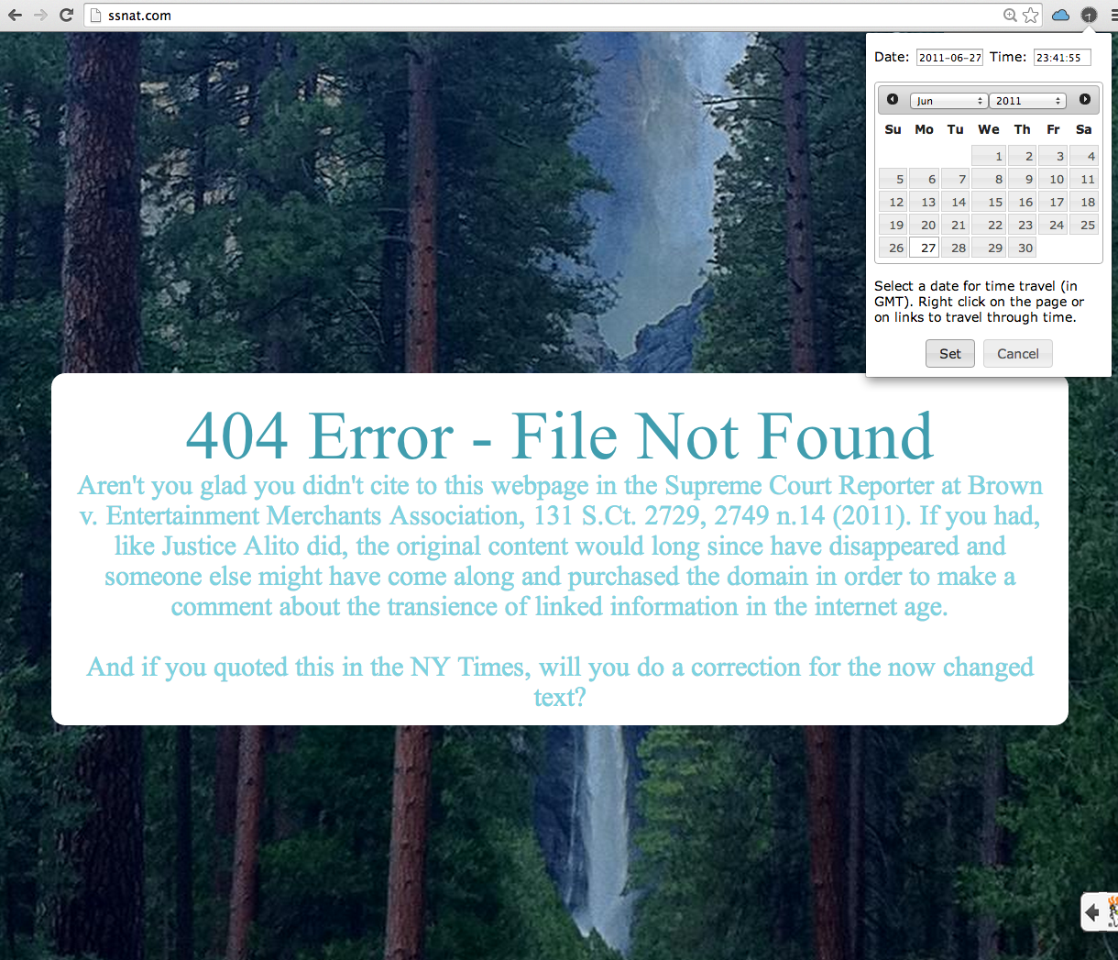
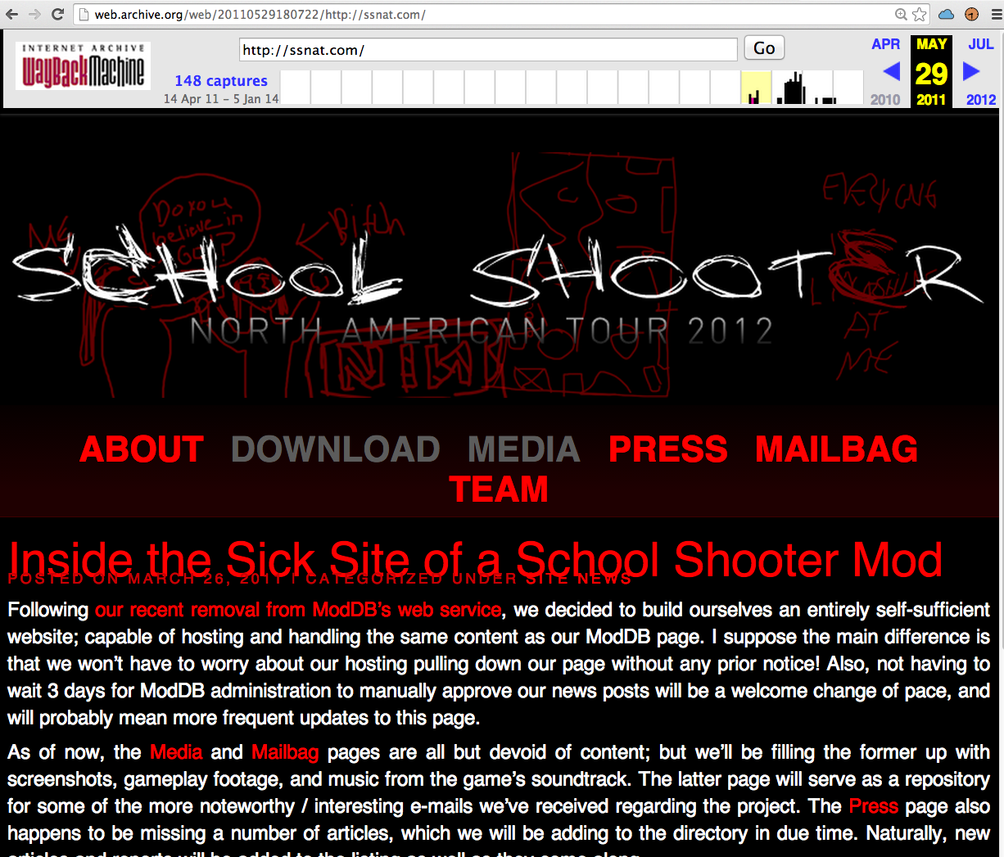
Memento: Access Versions via the Original URI and a Datetime
Select Date
June 27 2011
Today
May 29 2011
From
Internet Archive
4

Slide 5
The Memento protocol achieves this by introducing
a uniform, datetime-based, version access capability
that integrates the Present and Past Web.
5

Slide 6
Problem Statement …
6

Slide 7
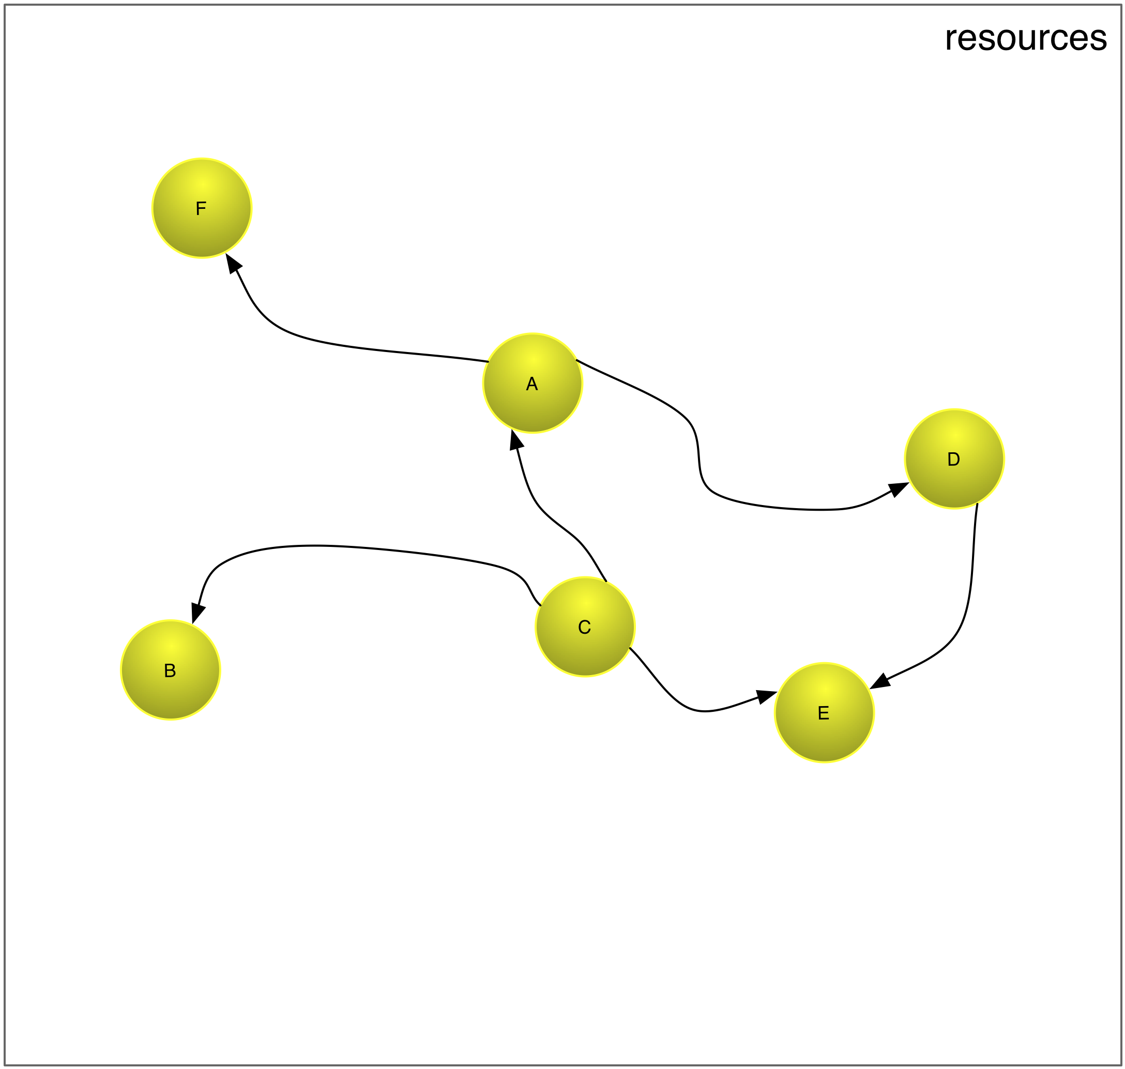
Resources
7

Slide 8
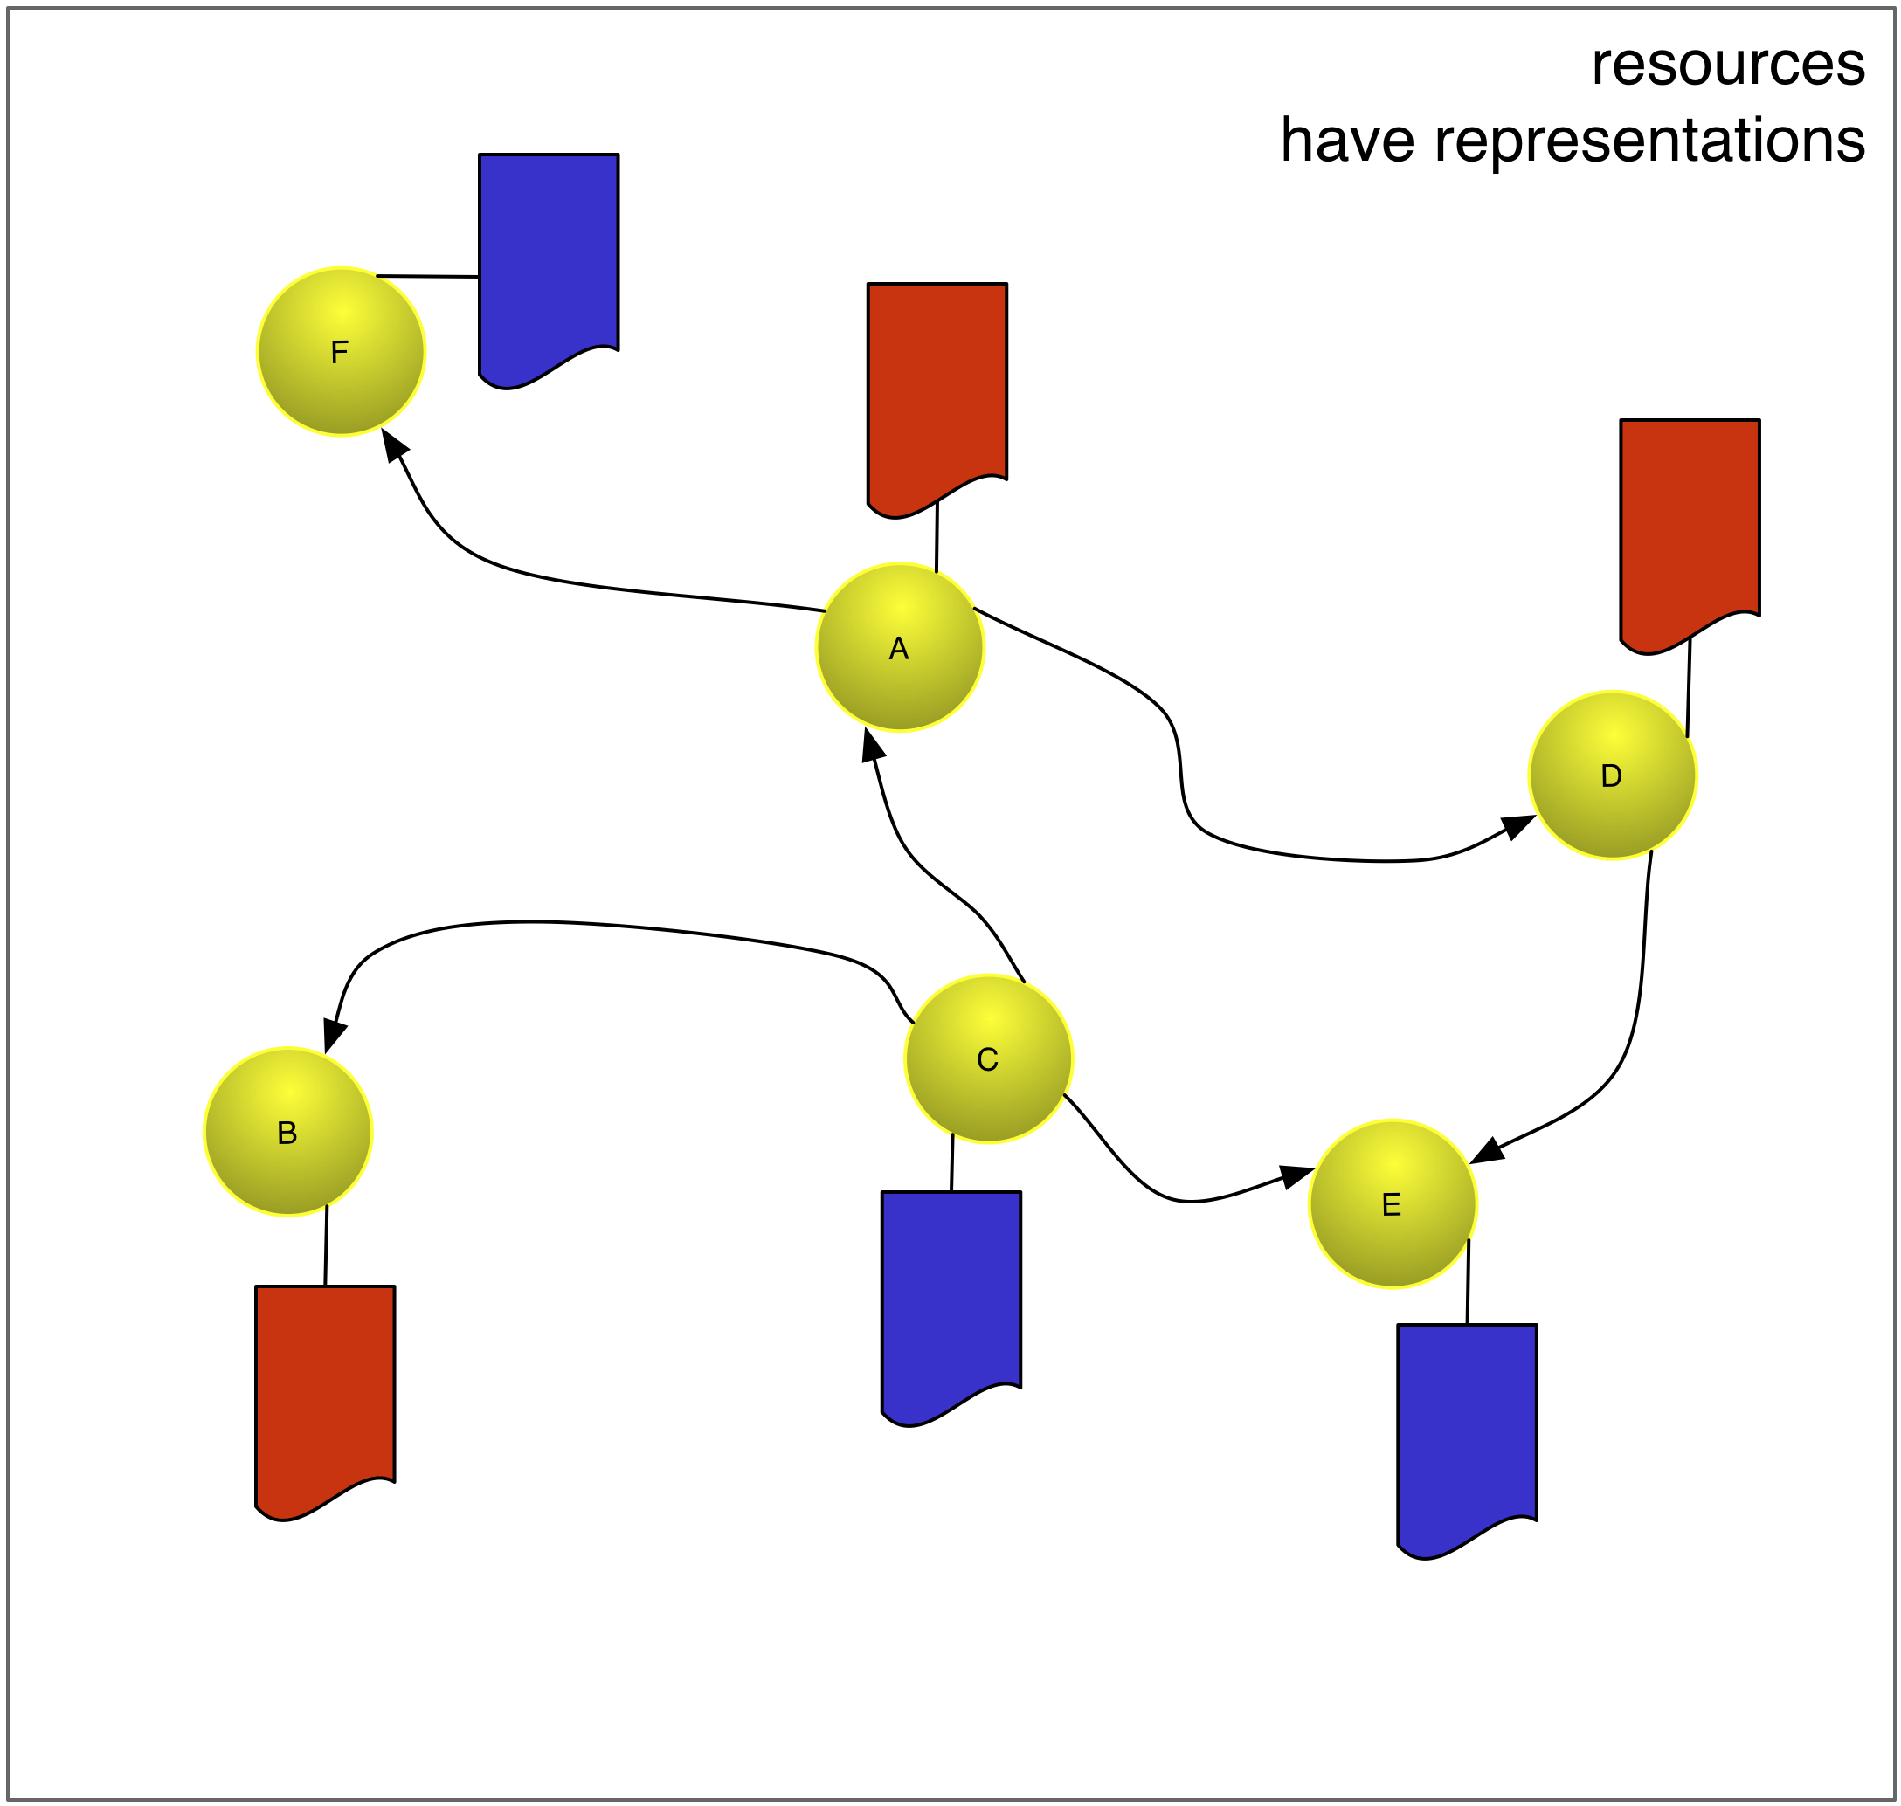
Resources have Representations
8

Slide 9
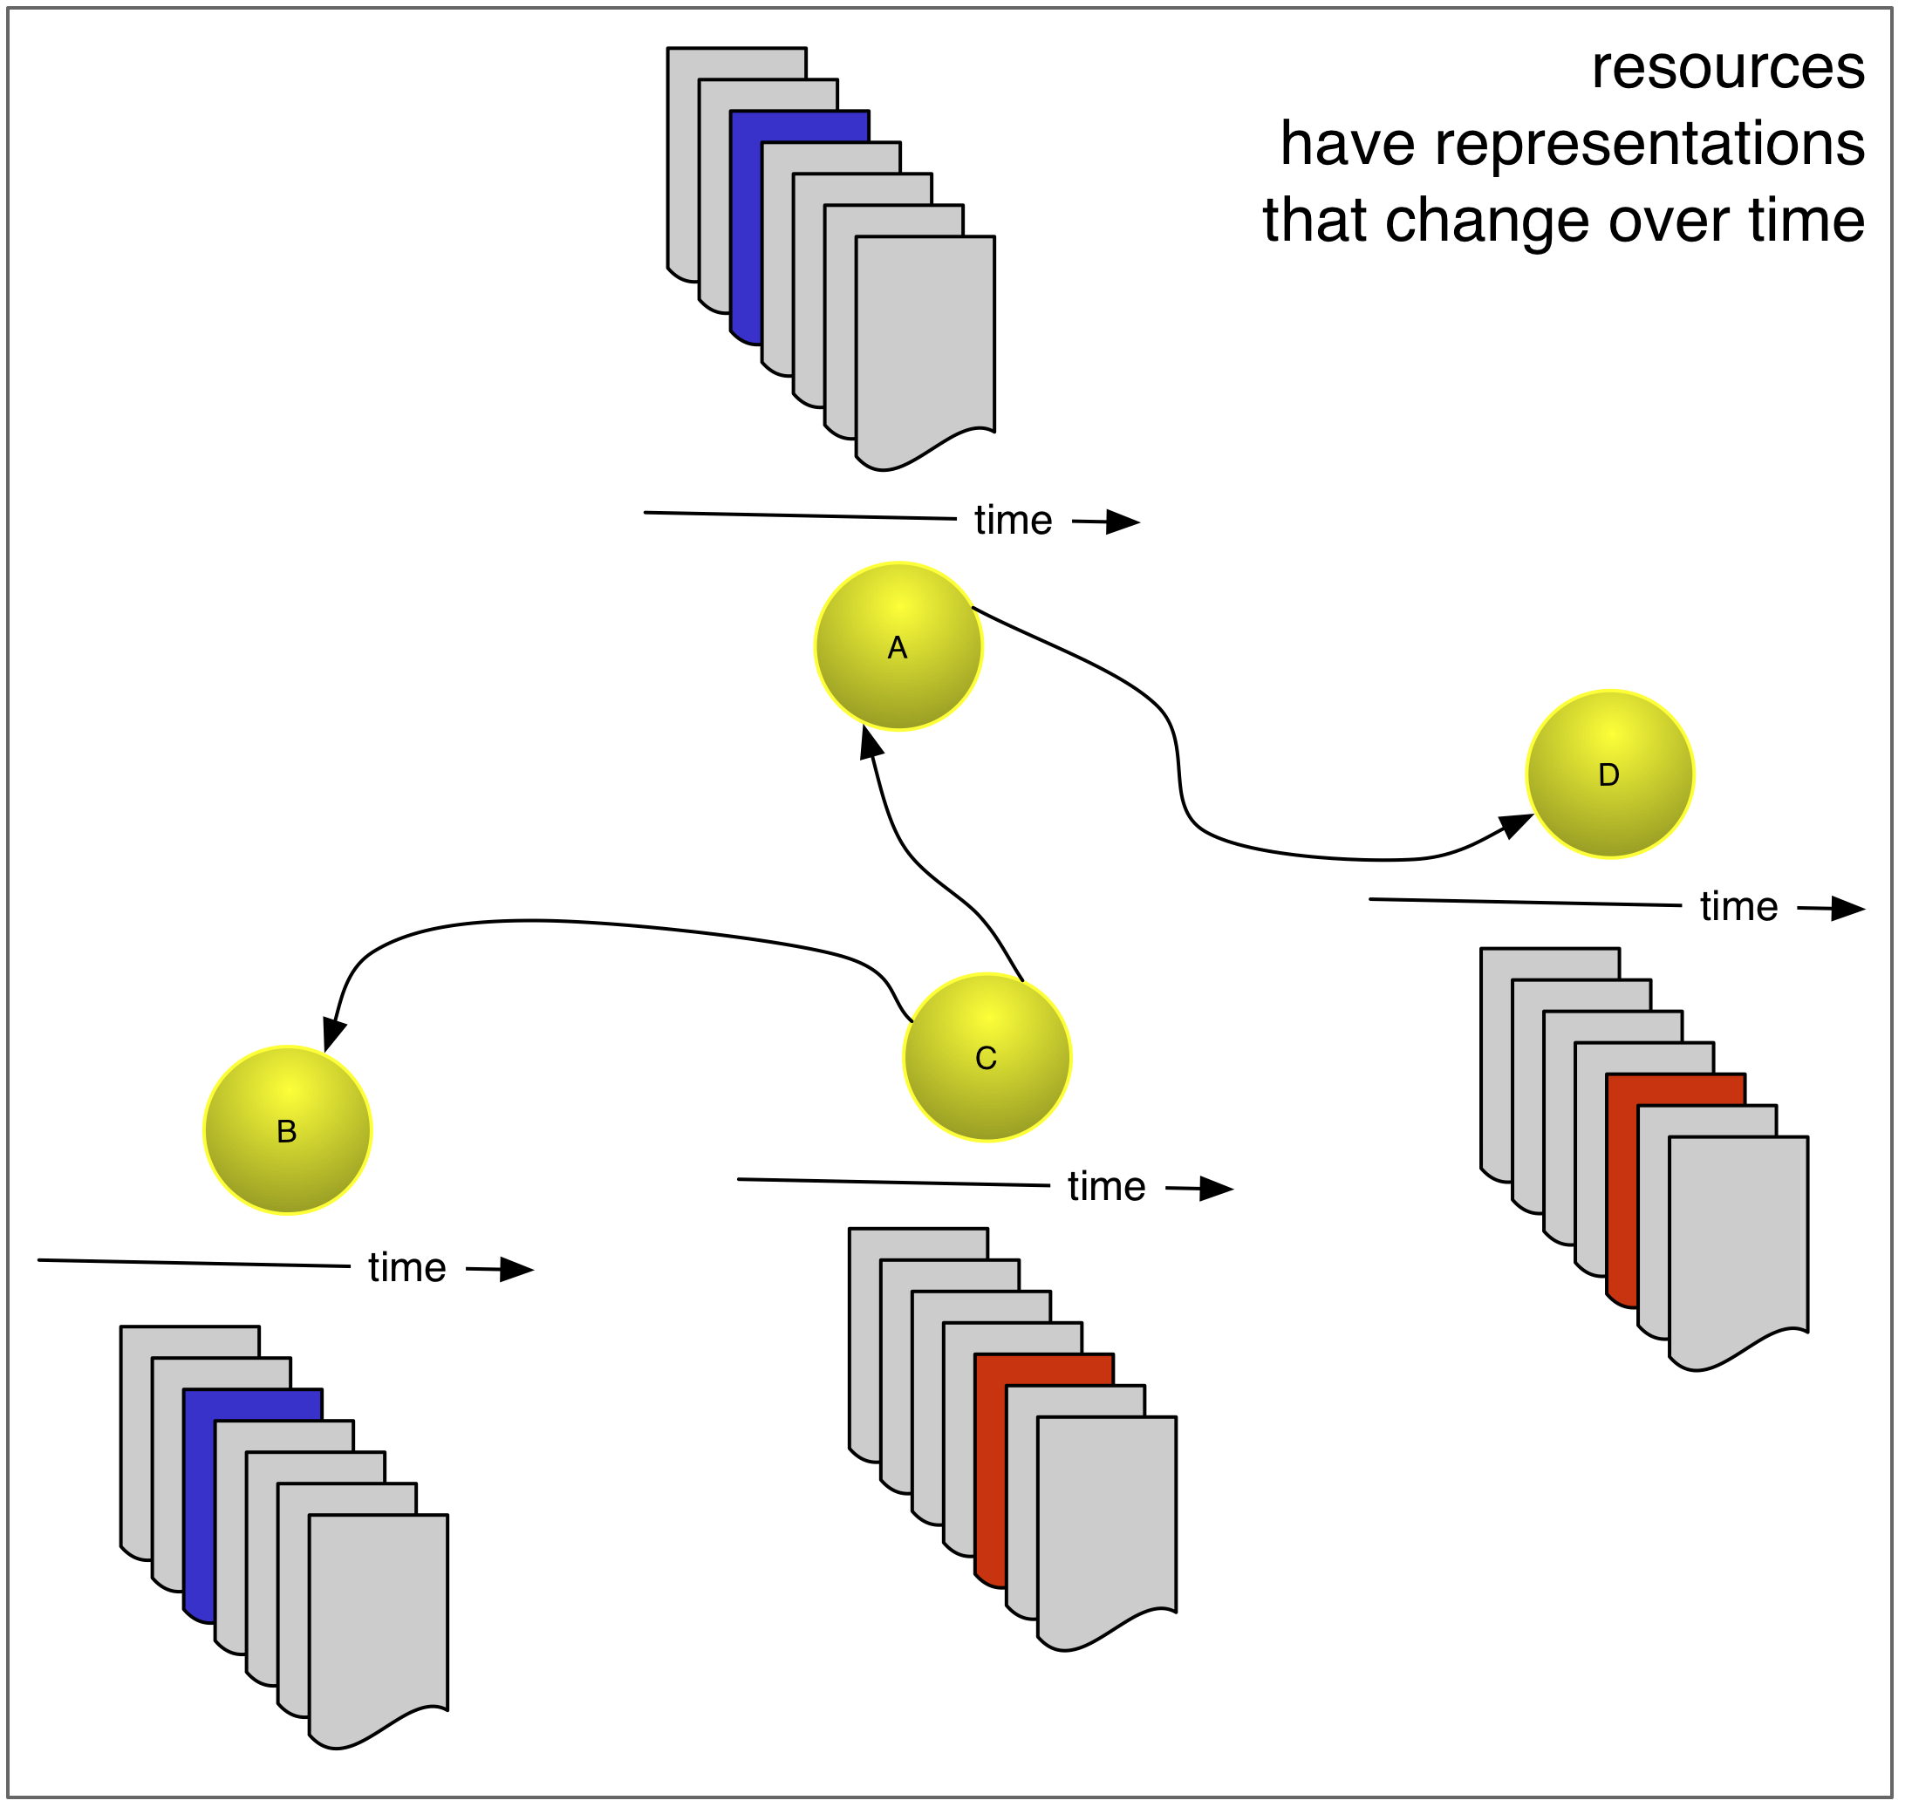
Resources have Representations that Change over Time
9

Slide 10
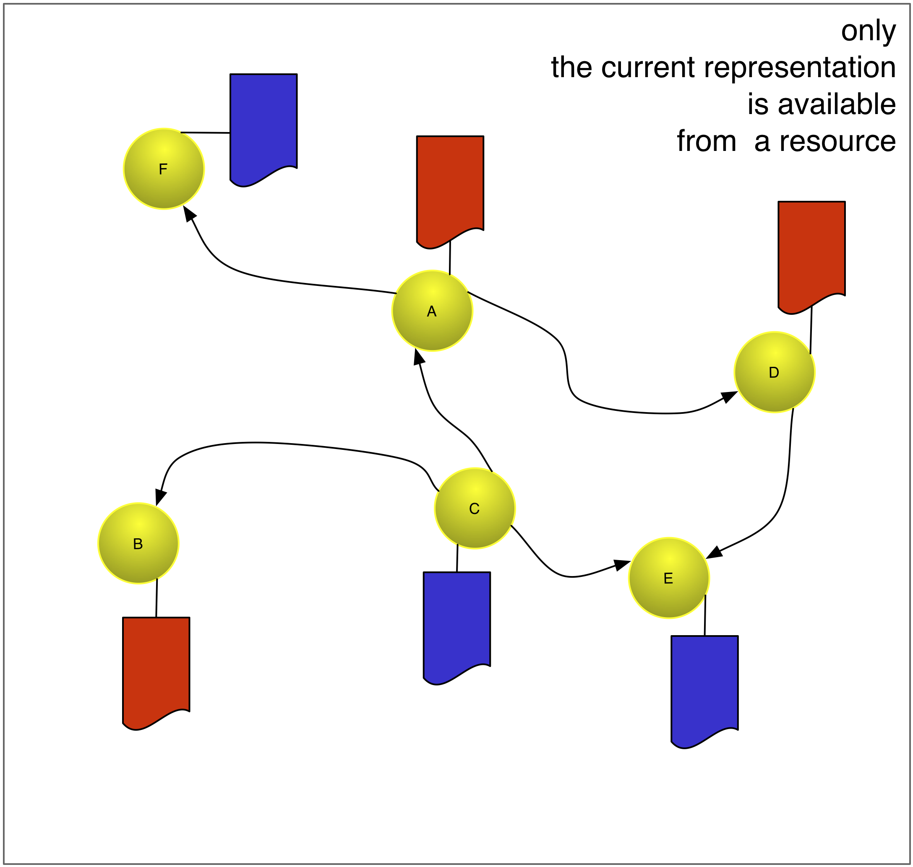
Only the Current Representation is Available from a Resource
10

Slide 11
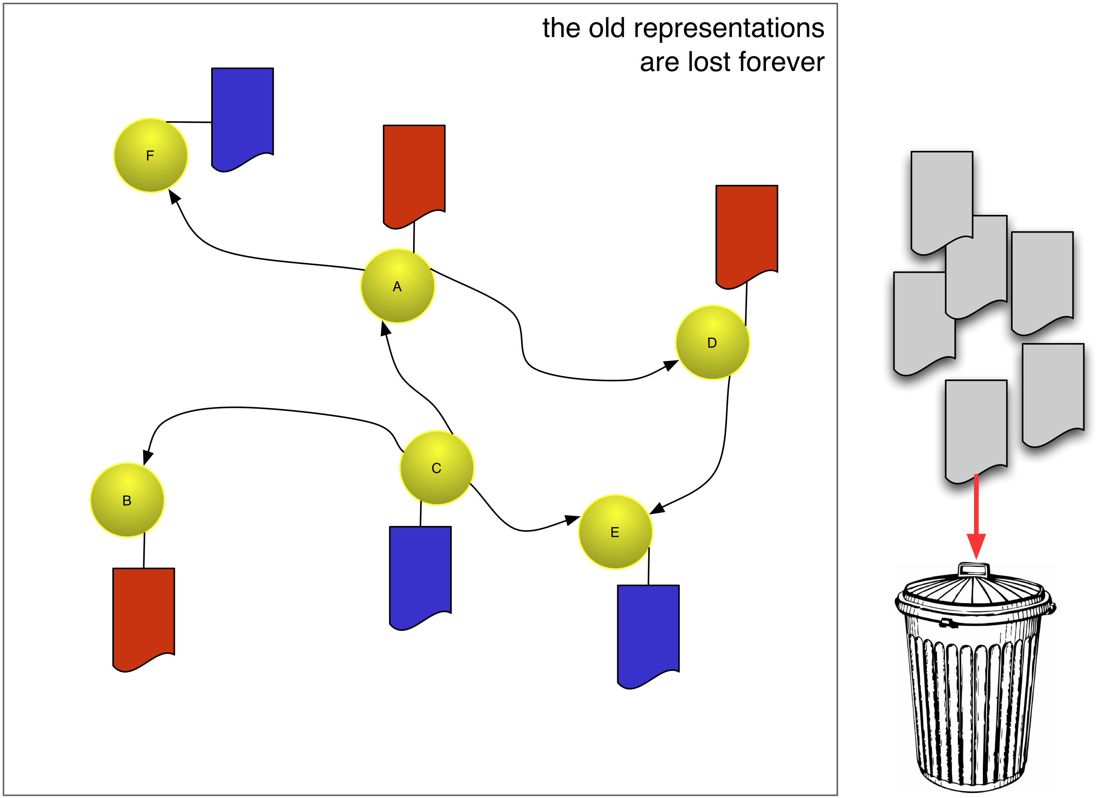
Old Representations are Lost Forever
11

Slide 12
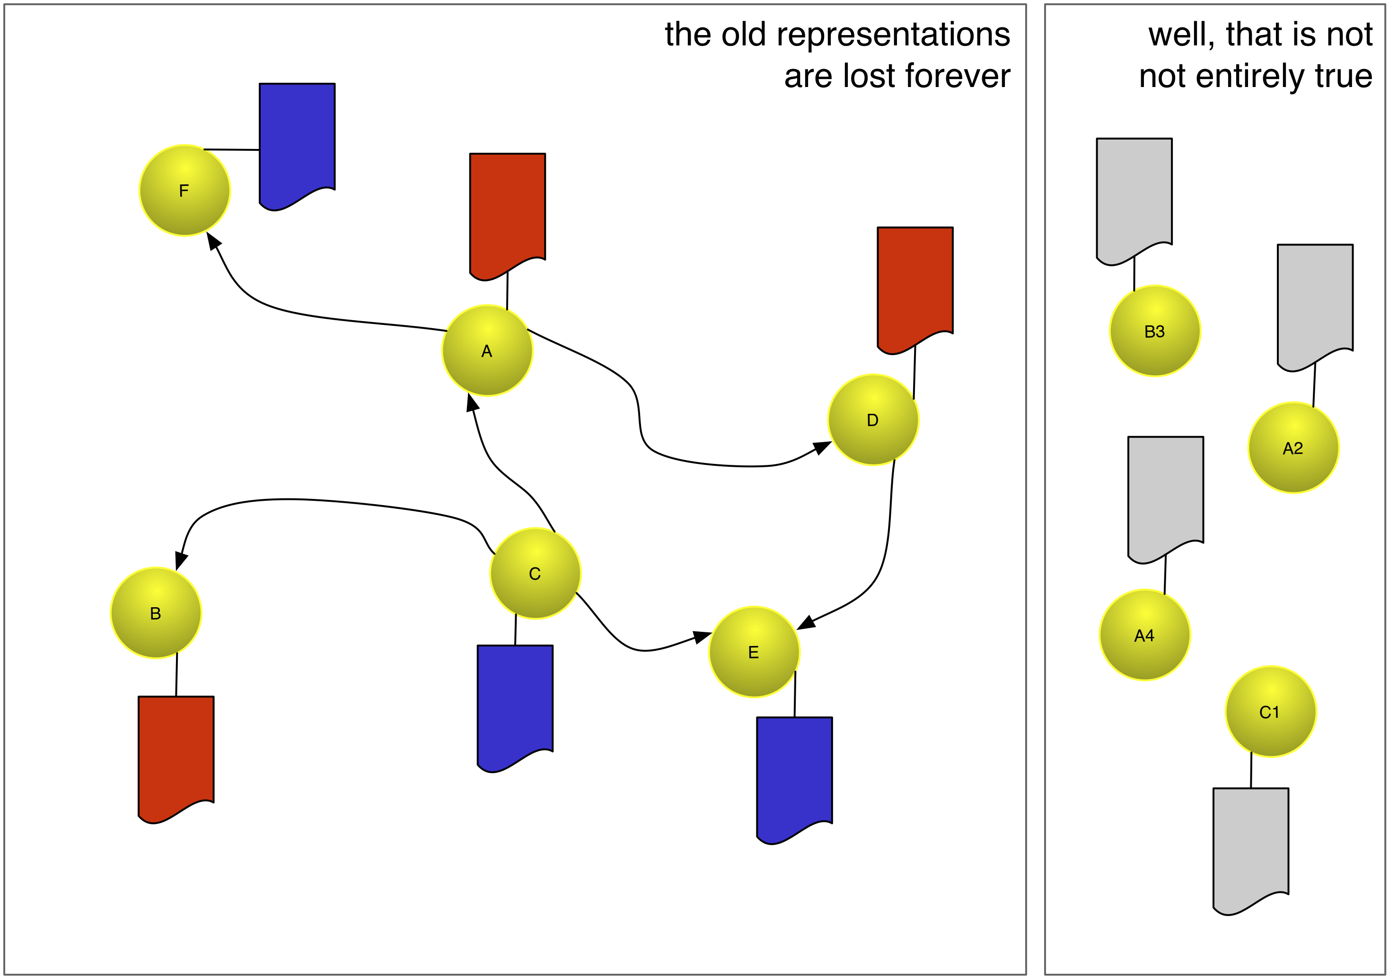
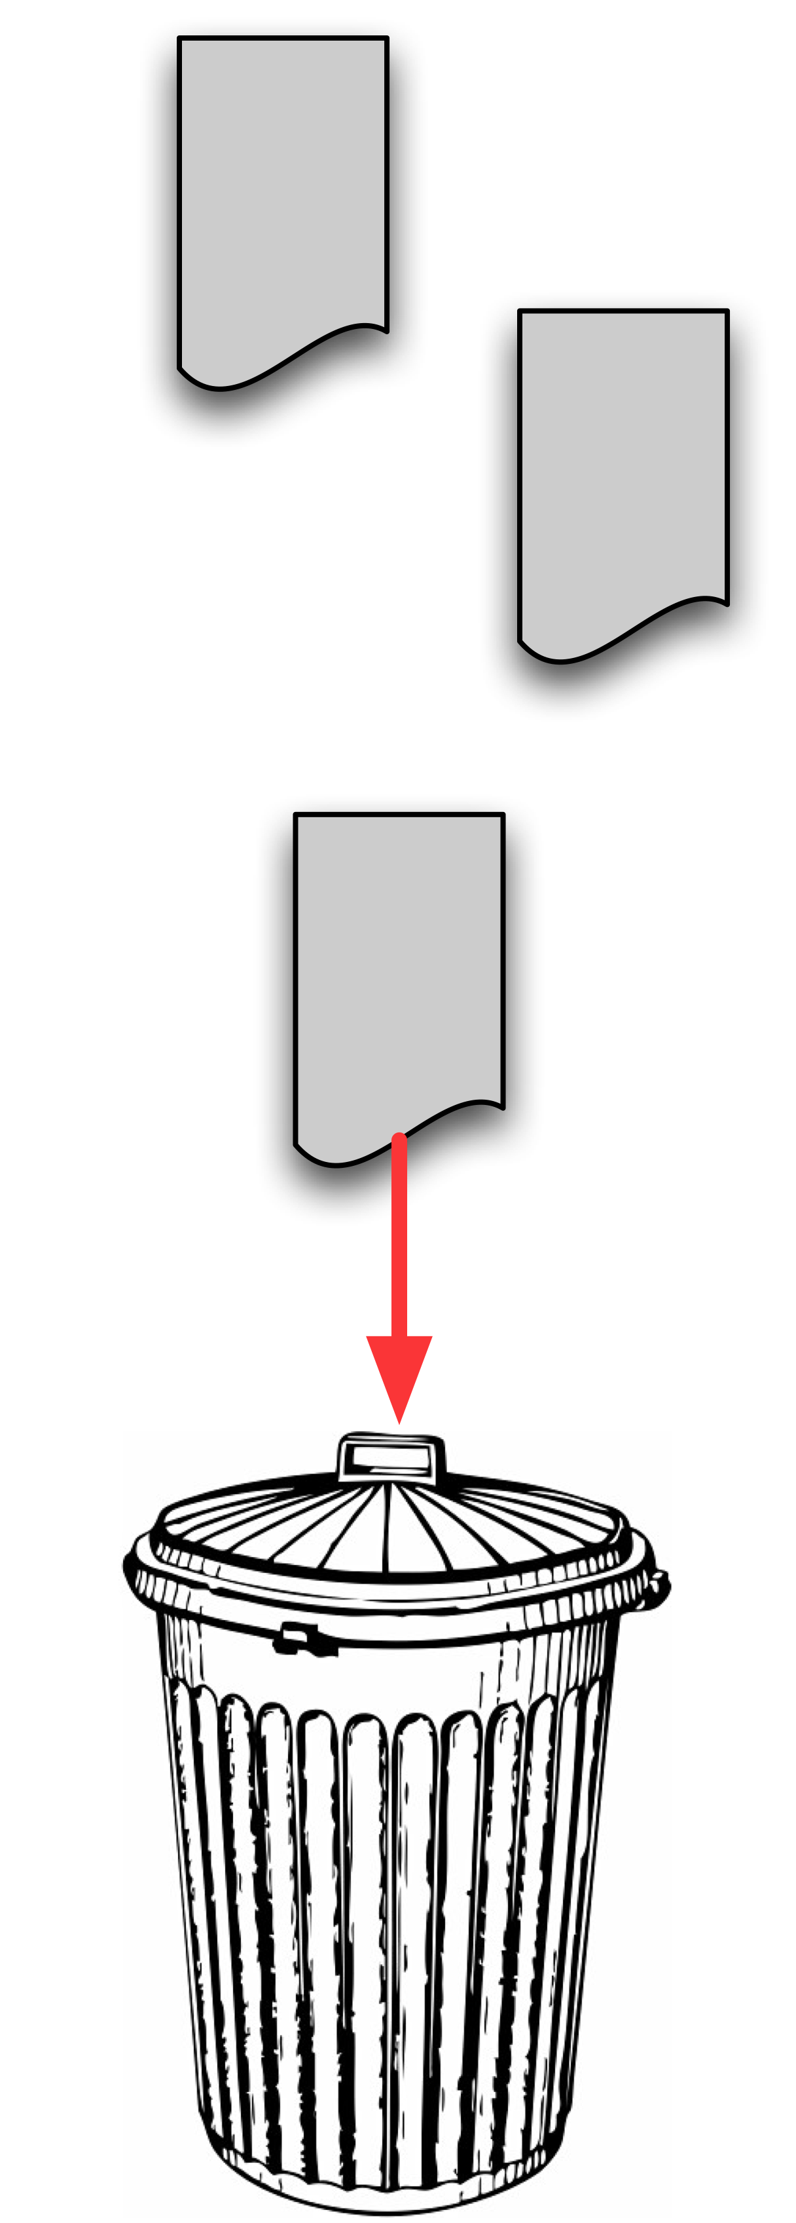
But … Archived/Version Resources Exist
12

Slide 13










There are resource versions on the Web, in:
Web Archives;
Content Management Systems;
Search engine caches;
Transactional archives.
13

Slide 14
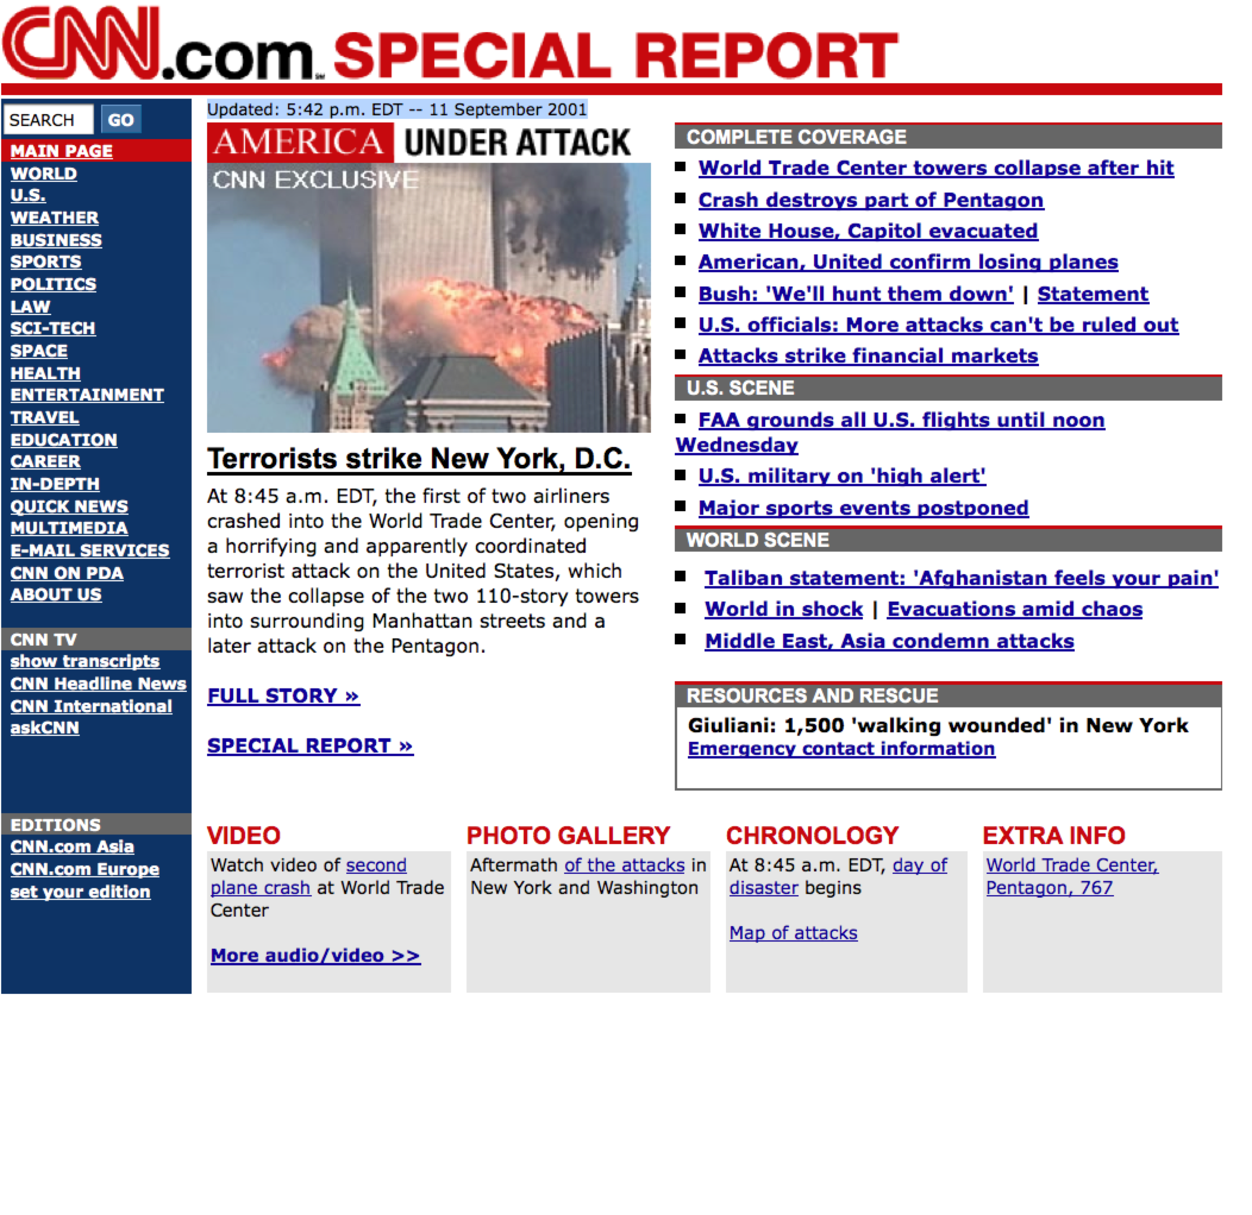
Archived Resource
Web Archive
URI-M - http://web.archive.org/web/20010911203610/http://www.cnn.com/
URI-R - http://www.cnn.com/
Notes:
They have in common: versions exist at different URIs. Because only the representation of a single state of a resource is available from a URI.

Slide 15
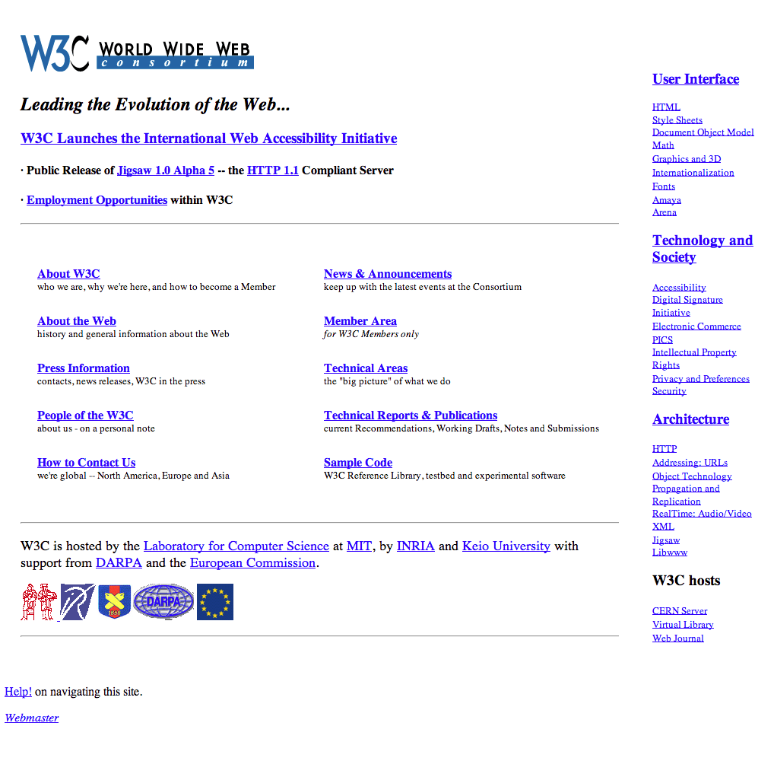

Archived Resource
Web Archive
URI-M - https://archive.today/UD0d6
URI-R - http://www.w3.org/
Notes:
They have in common: versions exist at different URIs. Because only the representation of a single state of a resource is available from a URI.

Slide 16
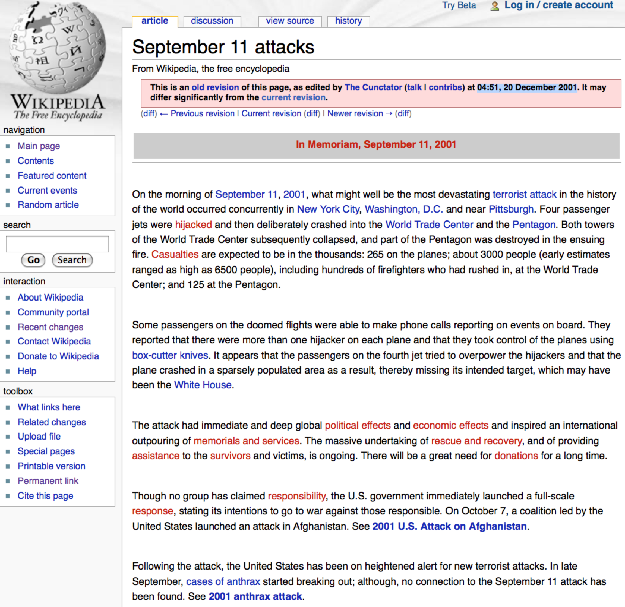
Version Resource
CMS
URI-M - http://en.wikipedia.org/w/index.php?title=September_11_attacks&oldid=282333
URI-R - http://en.wikipedia.org/wiki/September_11_attacks
Notes:
They have in common: versions exist at different URIs. Because only the representation of a single state of a resource is available from a URI.

Slide 17
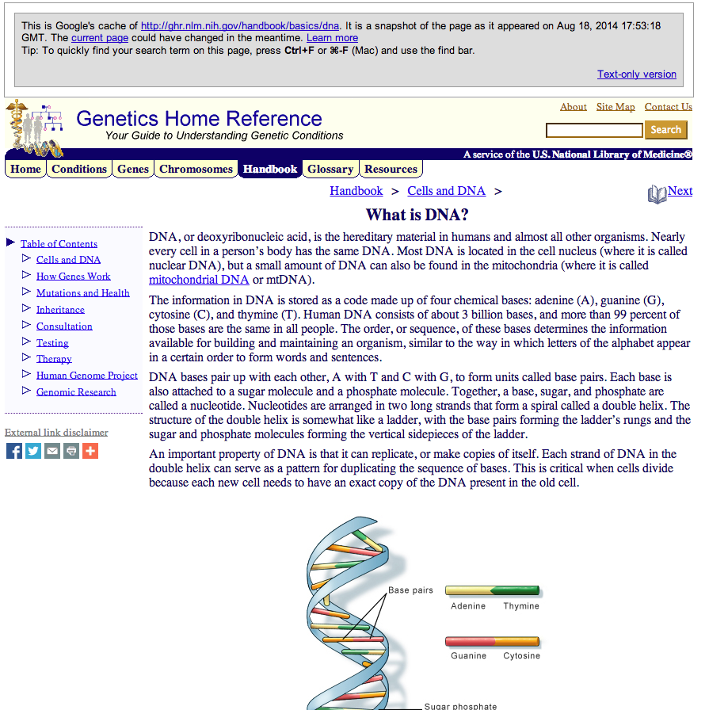
Cached Resource
Search Engine Cache
URI-M - http://webcache.googleusercontent.com/search?q=cache:kDmDc1PIA38J: ghr.nlm.nih.gov/handbook/basics/dna+&cd=2&hl=en&ct=clnk&gl=us
URI-R – http://ghr.nlm.nih.gov/handbook/basics/dna
Notes:
They have in common: versions exist at different URIs. Because only the representation of a single state of a resource is available from a URI.

Slide 18
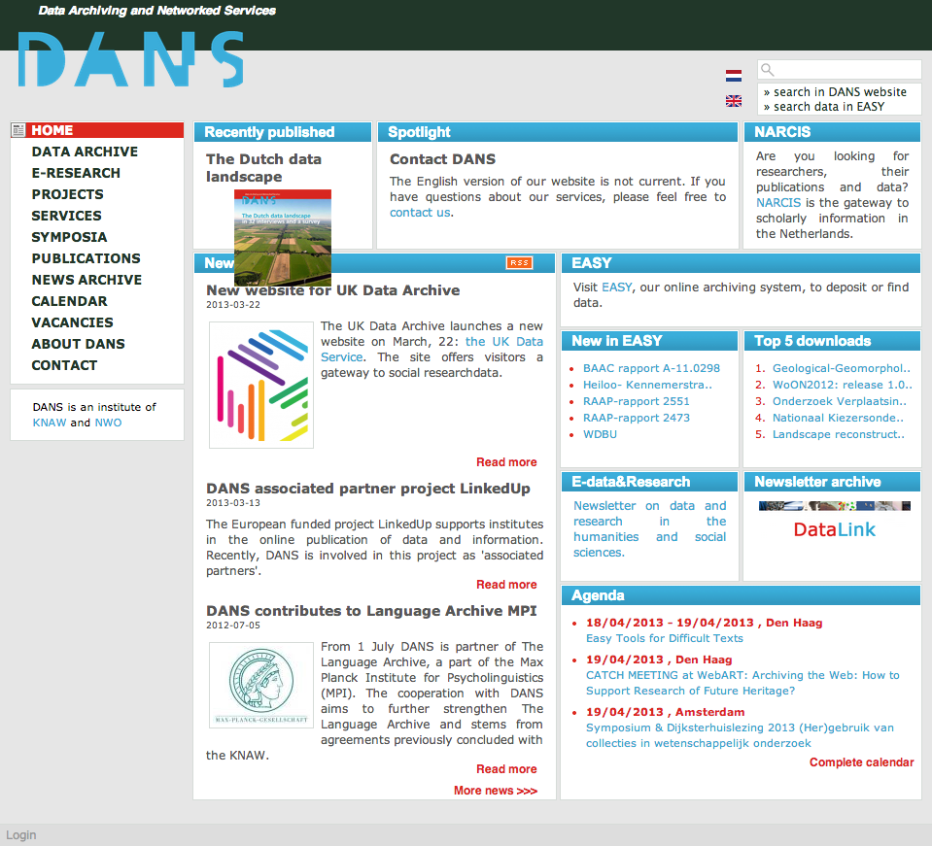
Archived Resource
Transactional Archive
URI-M - http://www.theresourcedepot.com/000010/memento/20130418204153/http://dans.knaw.nl/en
URI-R - http://dans.knaw.nl/en
Notes:
They have in common: versions exist at different URIs. Because only the representation of a single state of a resource is available from a URI.

Slide 19
But, without Memento, the Web handles these version resources poorly:
Cannot talk, in URI terms, about a resource as it used to exist
Cannot access a prior version knowing the current one
Cannot access the current version knowing a prior one
Solutions are ad hoc and localized
19

Slide 20
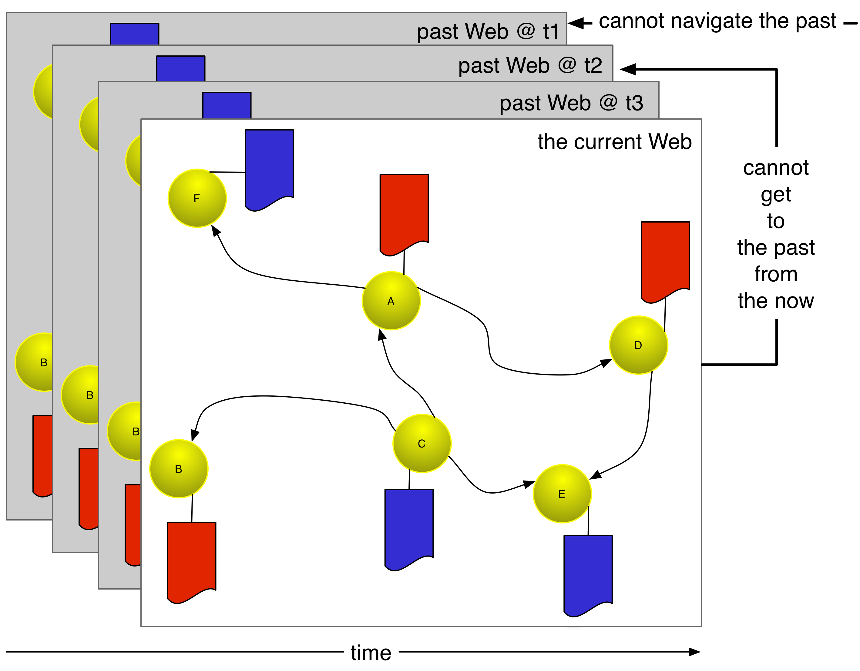
Without Memento, the Current and Past Web Lack Integration
Going from Current to Past Web is a matter of (manual) discovery
Navigating the Past Web is only possible within the boundary of a single web archive, versioning system
Memento integrates the Current And Past Web by means of an extension of HTTP
Memento turns archives, versioning systems into infrastructure rather than destinations
20

Slide 21
Systems with Resource Versions
system type | stores | URI-R and URI-M
web archive | observations over time | different baseURL
CMS | history | same baseURL
search engine cache | one recent observation | different baseURL
transactional archive | history | different baseURL
These systems have different characteristics
but the Memento protocol allows uniform versions access to their resources
21

Slide 22
The Memento Framework: Protocol to Integrate Present and Past Web Overview
22

Slide 23
The Memento protocol:
Regards the Web as a big Content Management System
Introduces an interoperable approach to access resource versions across the Web
Does not build new archives but leverages all systems that host versions
23

Slide 24
Memento’s approach to access resource versions:
Is distributed: versions may exist on several servers
Uses time as a global version indicator
Is based on the primitives of the Web: resource, state, representation, content negotiation, link
24

Slide 25
Memento’s approach to access resource versions has two components:
Access to a single archived/version resource – via datetime negotiation with a TimeGate
Access to an overview of existing versions – by requesting a TimeMap
25

Slide 26
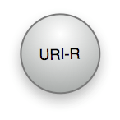

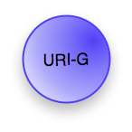

Memento Protocol Resource Types
Original Resource: Resource that exists or used to exist;
we are interested in accessing a past state of it
Memento: Resource that is a prior version of the Original Resource; it encapsulates a past state of the Original Resource
TimeGate: Resource that “decides”, based on a given datetime, which is the temporally best Memento for an Original Resource
TimeMap: Resource that provides a list of known Mementos for an Original Resource as well as their datetime
26

Slide 27
The Memento Framework: Protocol to Integrate Present and Past Web Datetime Negotiation
27

Slide 28
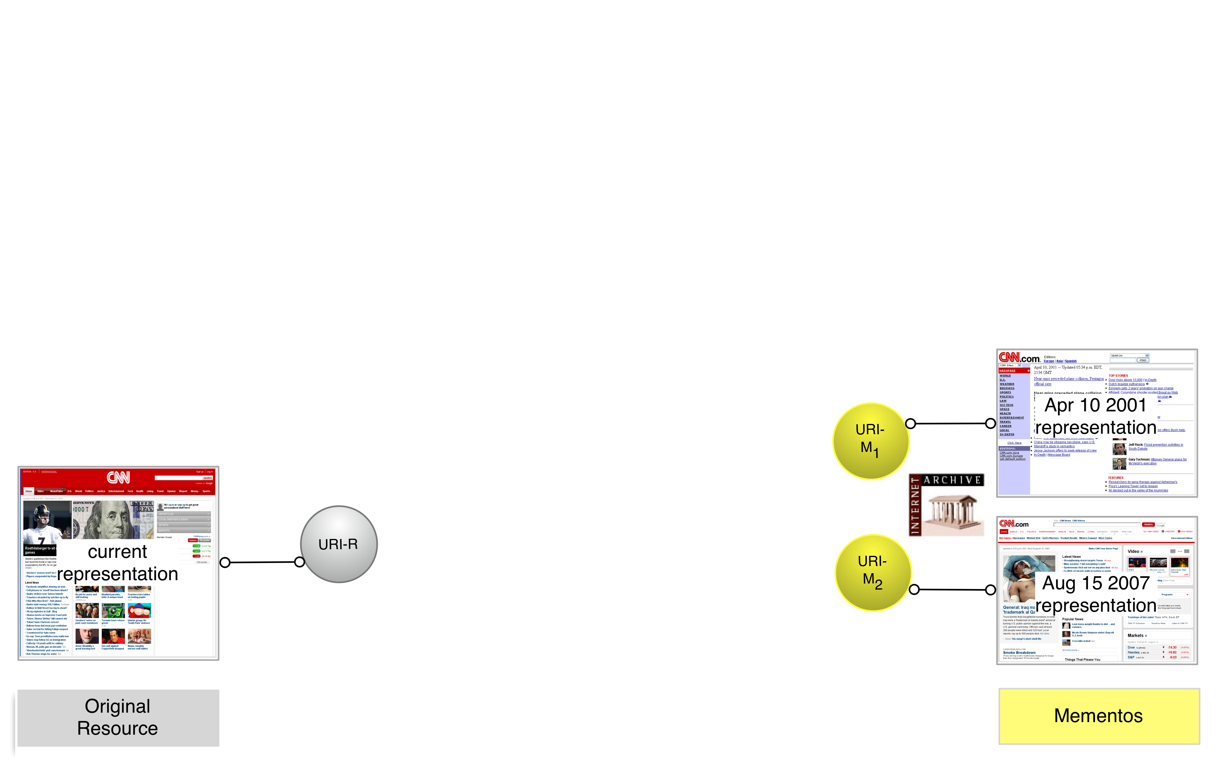
Original Resource and Mementos
28

Slide 29
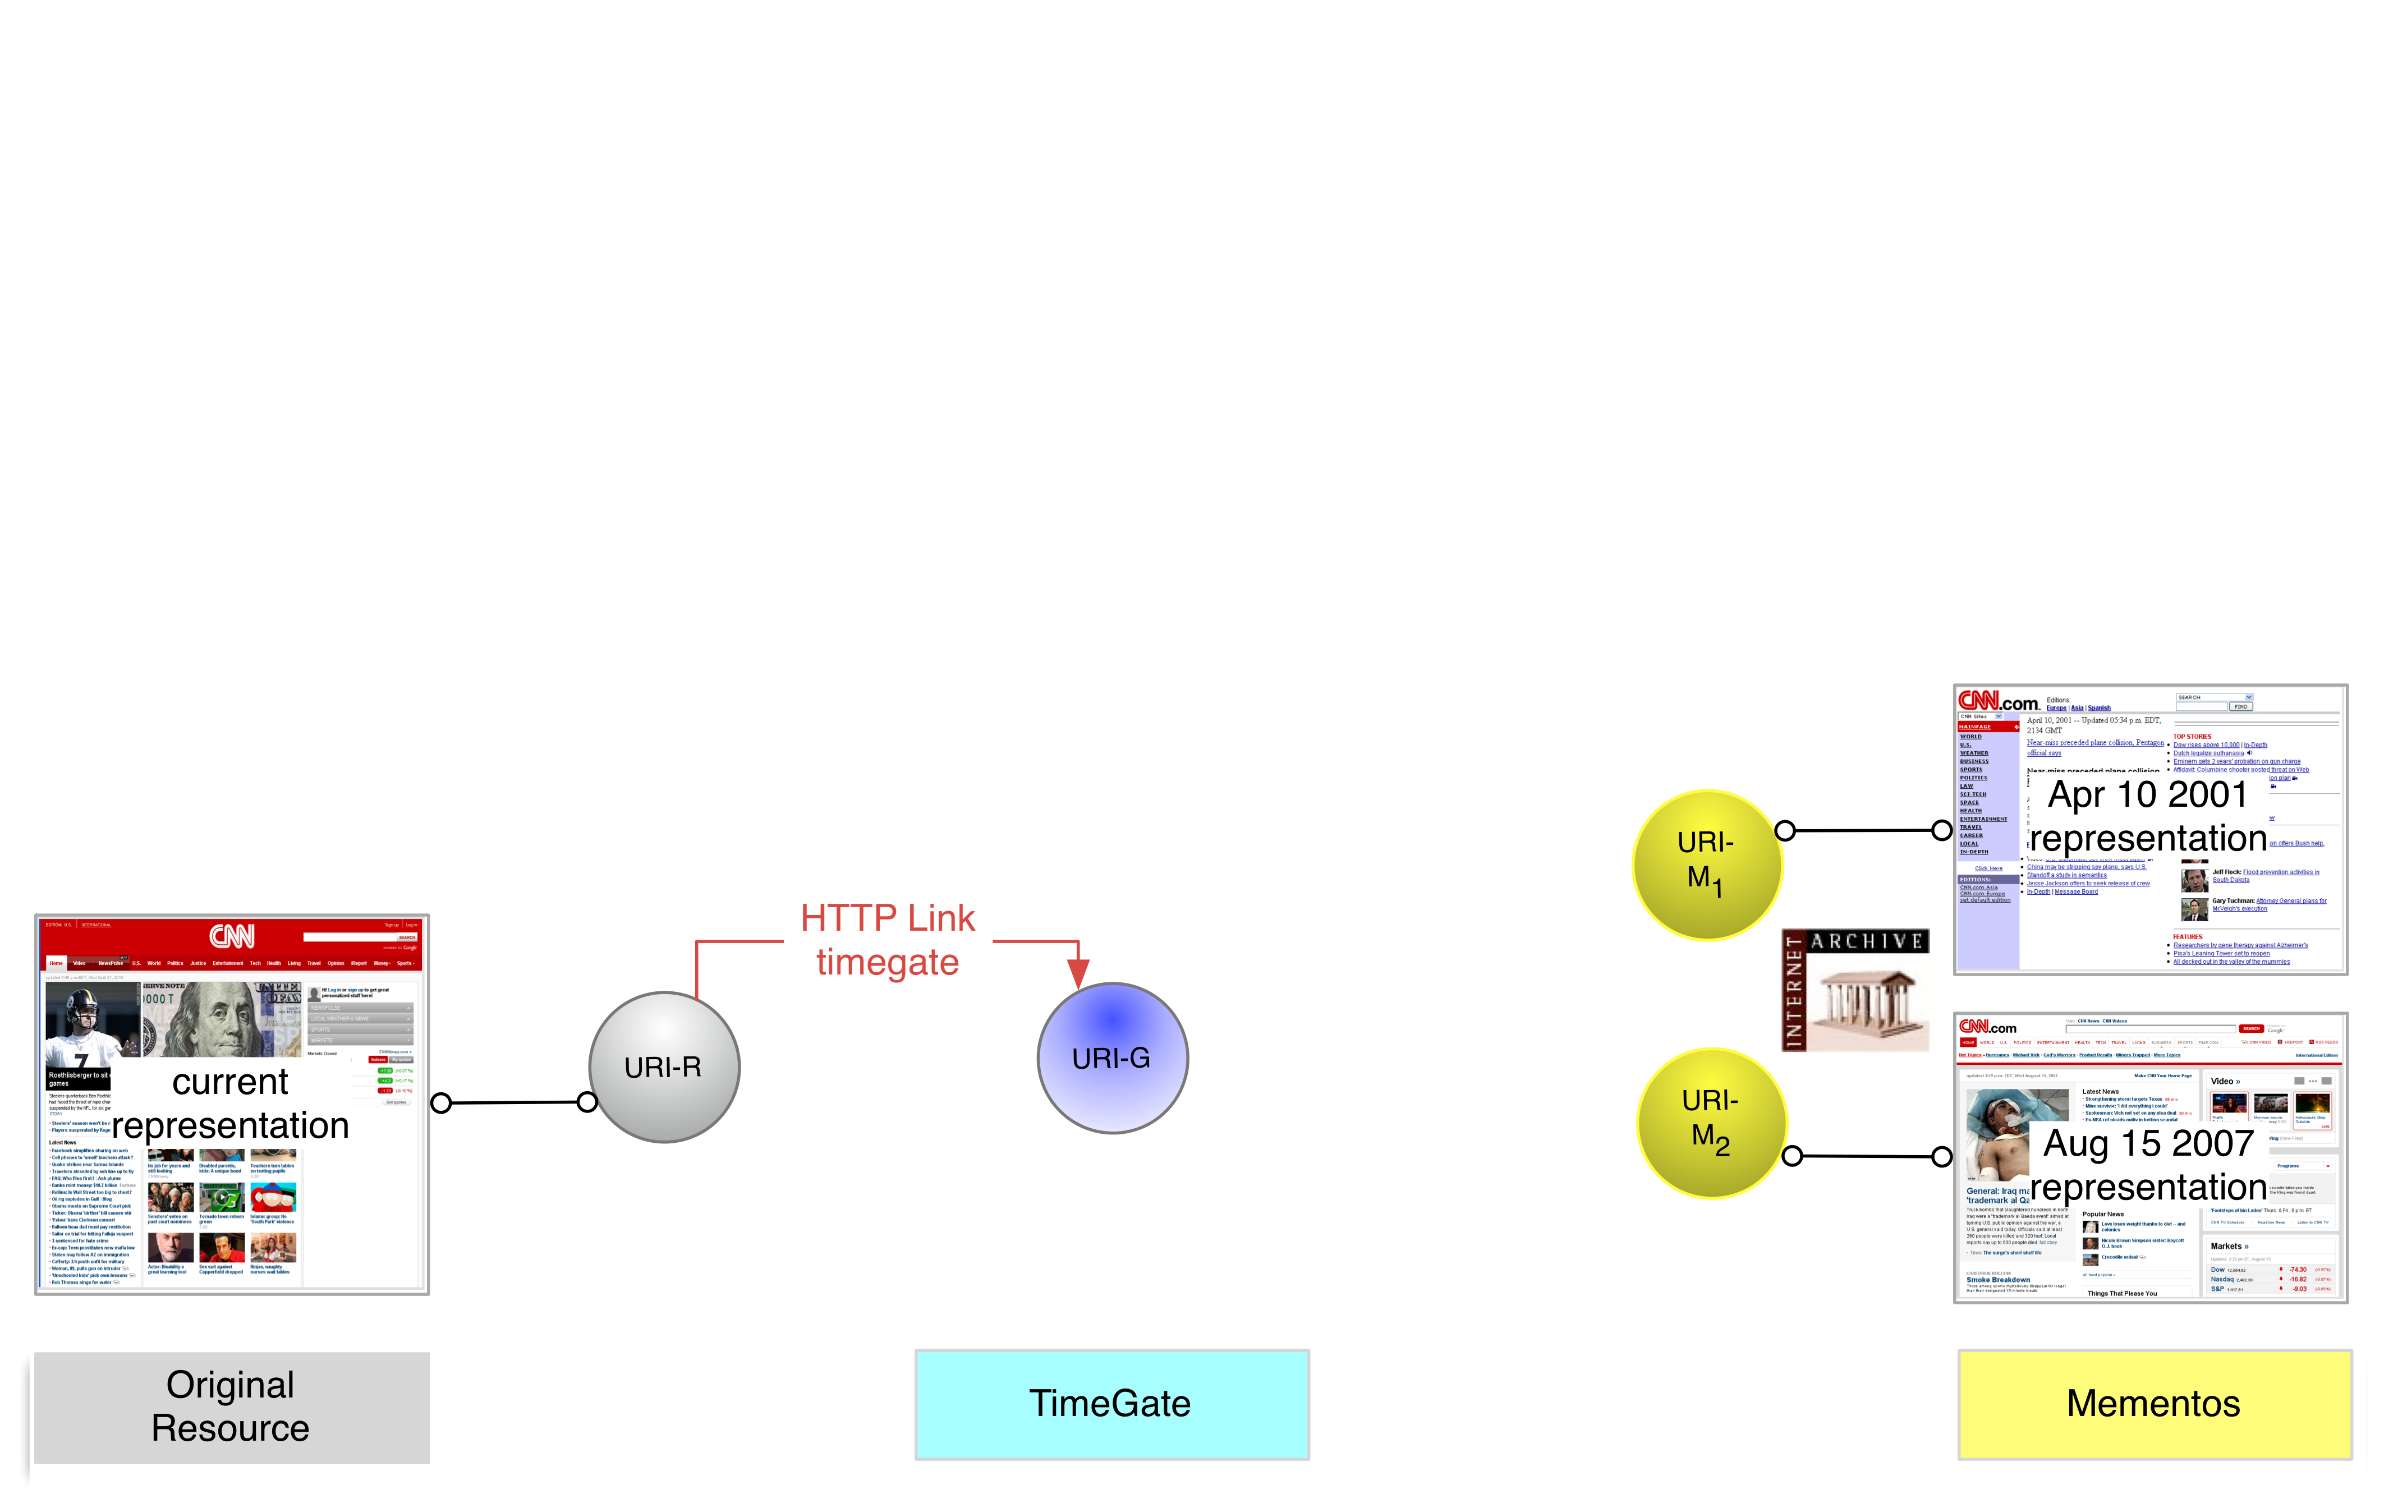
Bridge from Present to Past
29

Slide 30
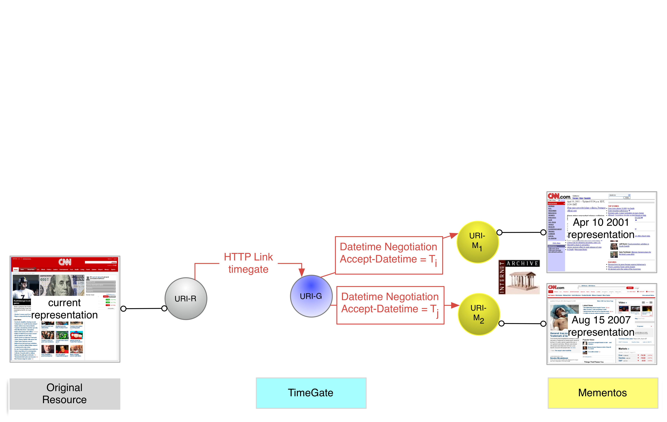
Bridge from Present to Past
30

Slide 31

Bridge from Past to Present
31

Slide 32
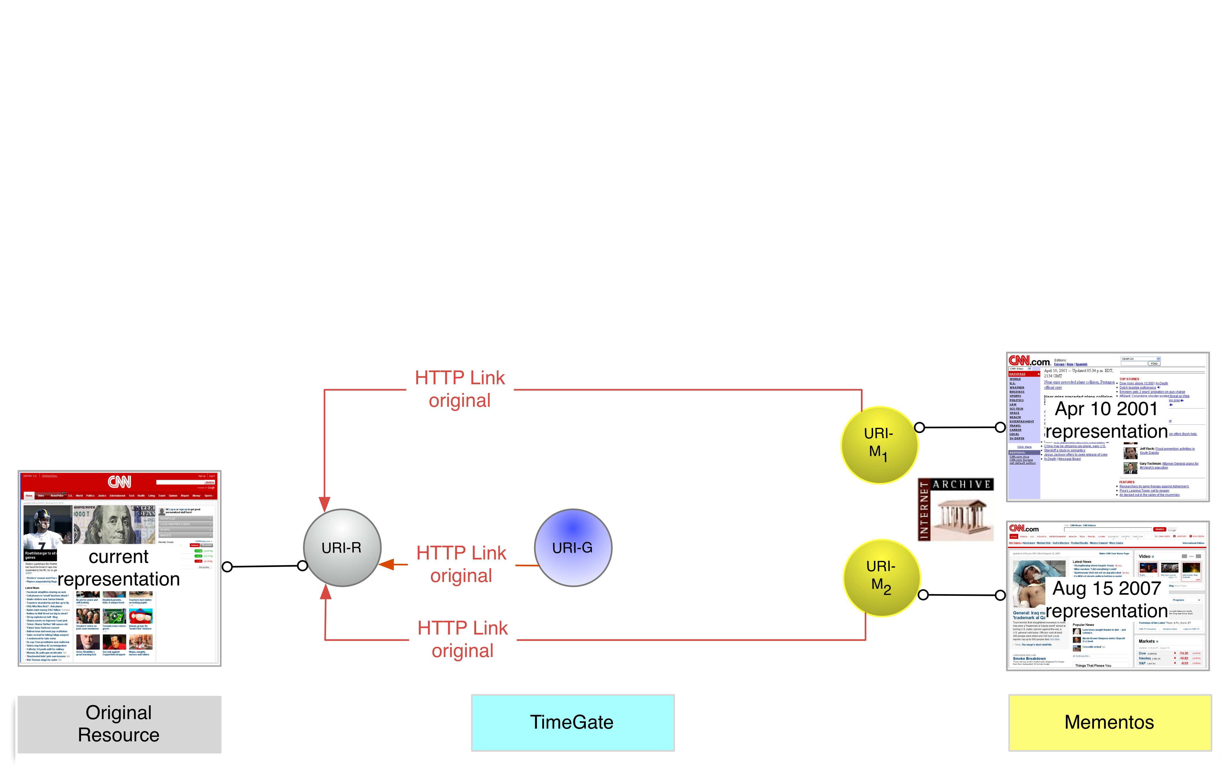
Bridge from Past to Present
32

Slide 33
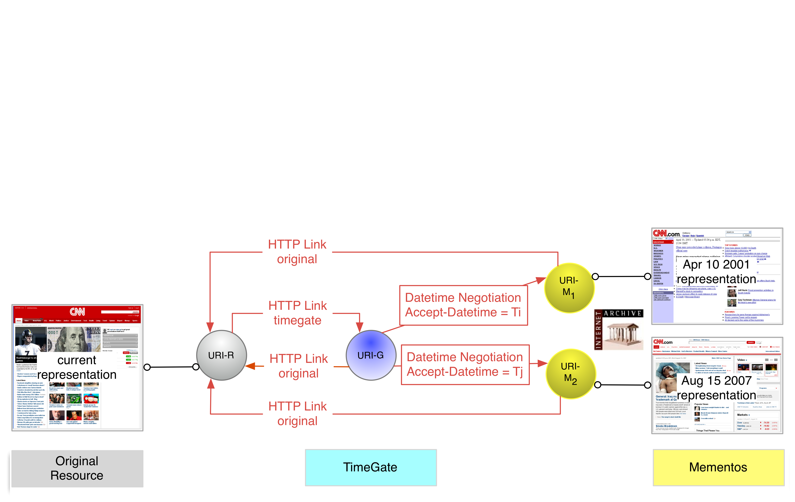
Memento Datetime Negotiation Component
33

Slide 34
Memento Protocol Datetime Negotiation Patterns
can coincide with
can coincide with
302 or 200 style negotiation can be used
The different Patterns are discussed in RFC 7089
Here, we deal with URI-R <> URI-G <> URI-M and 302 style negotiation
34

Slide 35
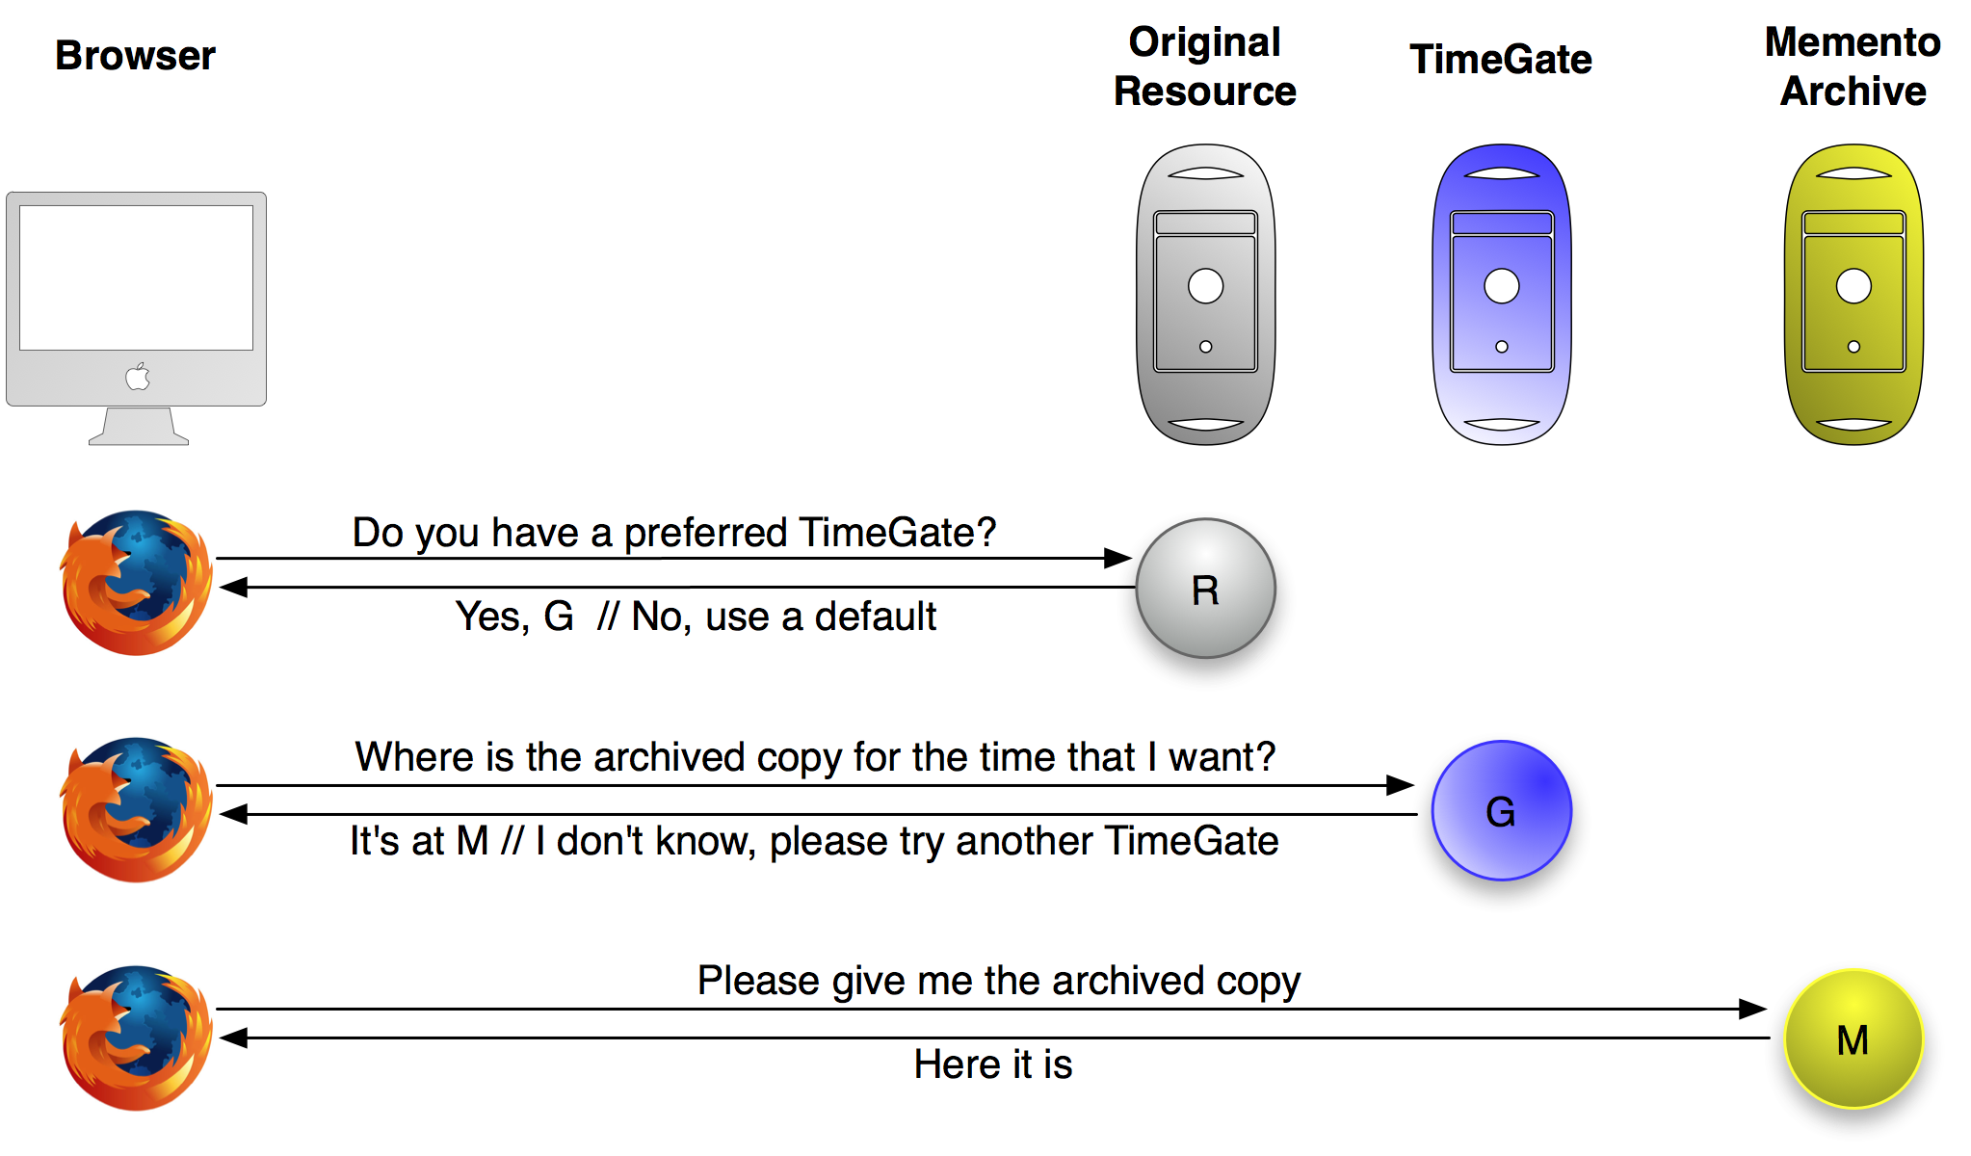

Memento Datetime Negotiation - Client Server Interaction
Yes, G
It’s at M
35

Slide 36
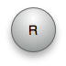



Memento Datetime Negotiation - HTTP Flow
HEAD R, [Accept-Datetime]
[Link ➔ G]
HEAD G, Accept-Datetime
302 ➔ M, Vary, Link ➔ R,[M,T]
GET M, [Accept-Datetime]
200, Memento-Datetime, Link ➔ R,[G,M,T]
[…]== optional

Slide 37
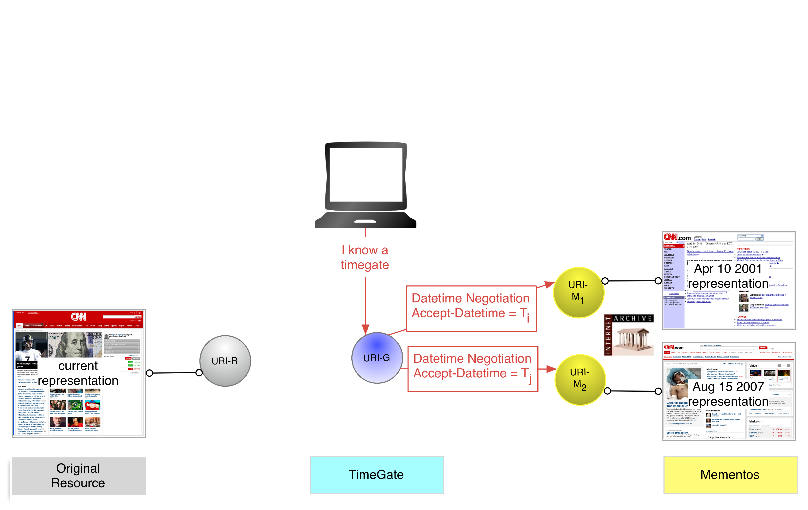
Original Resource Provides No Link – Client Intelligence
37

Slide 38
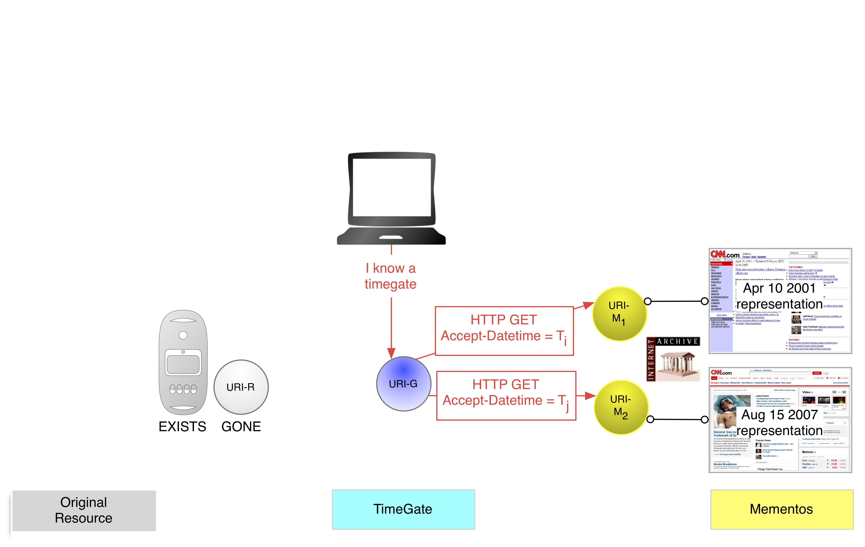
Original Resource Gone – Client Intelligence
38

Slide 39
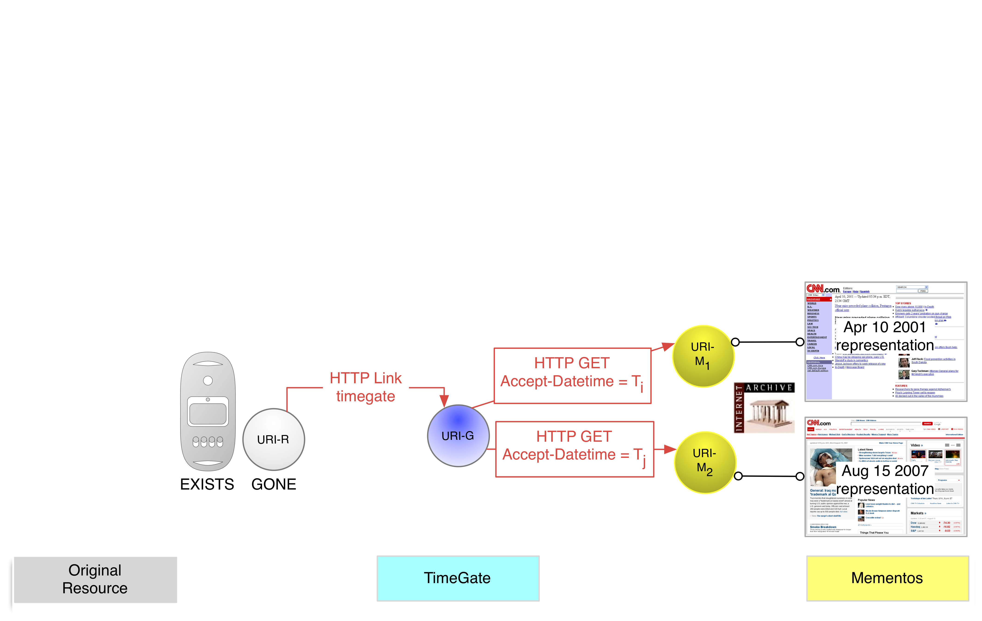
Original Resource Gone – Server Due Dilligence
39

Slide 40

Original Resource’s Server Gone – Client Intelligence
40

Slide 41
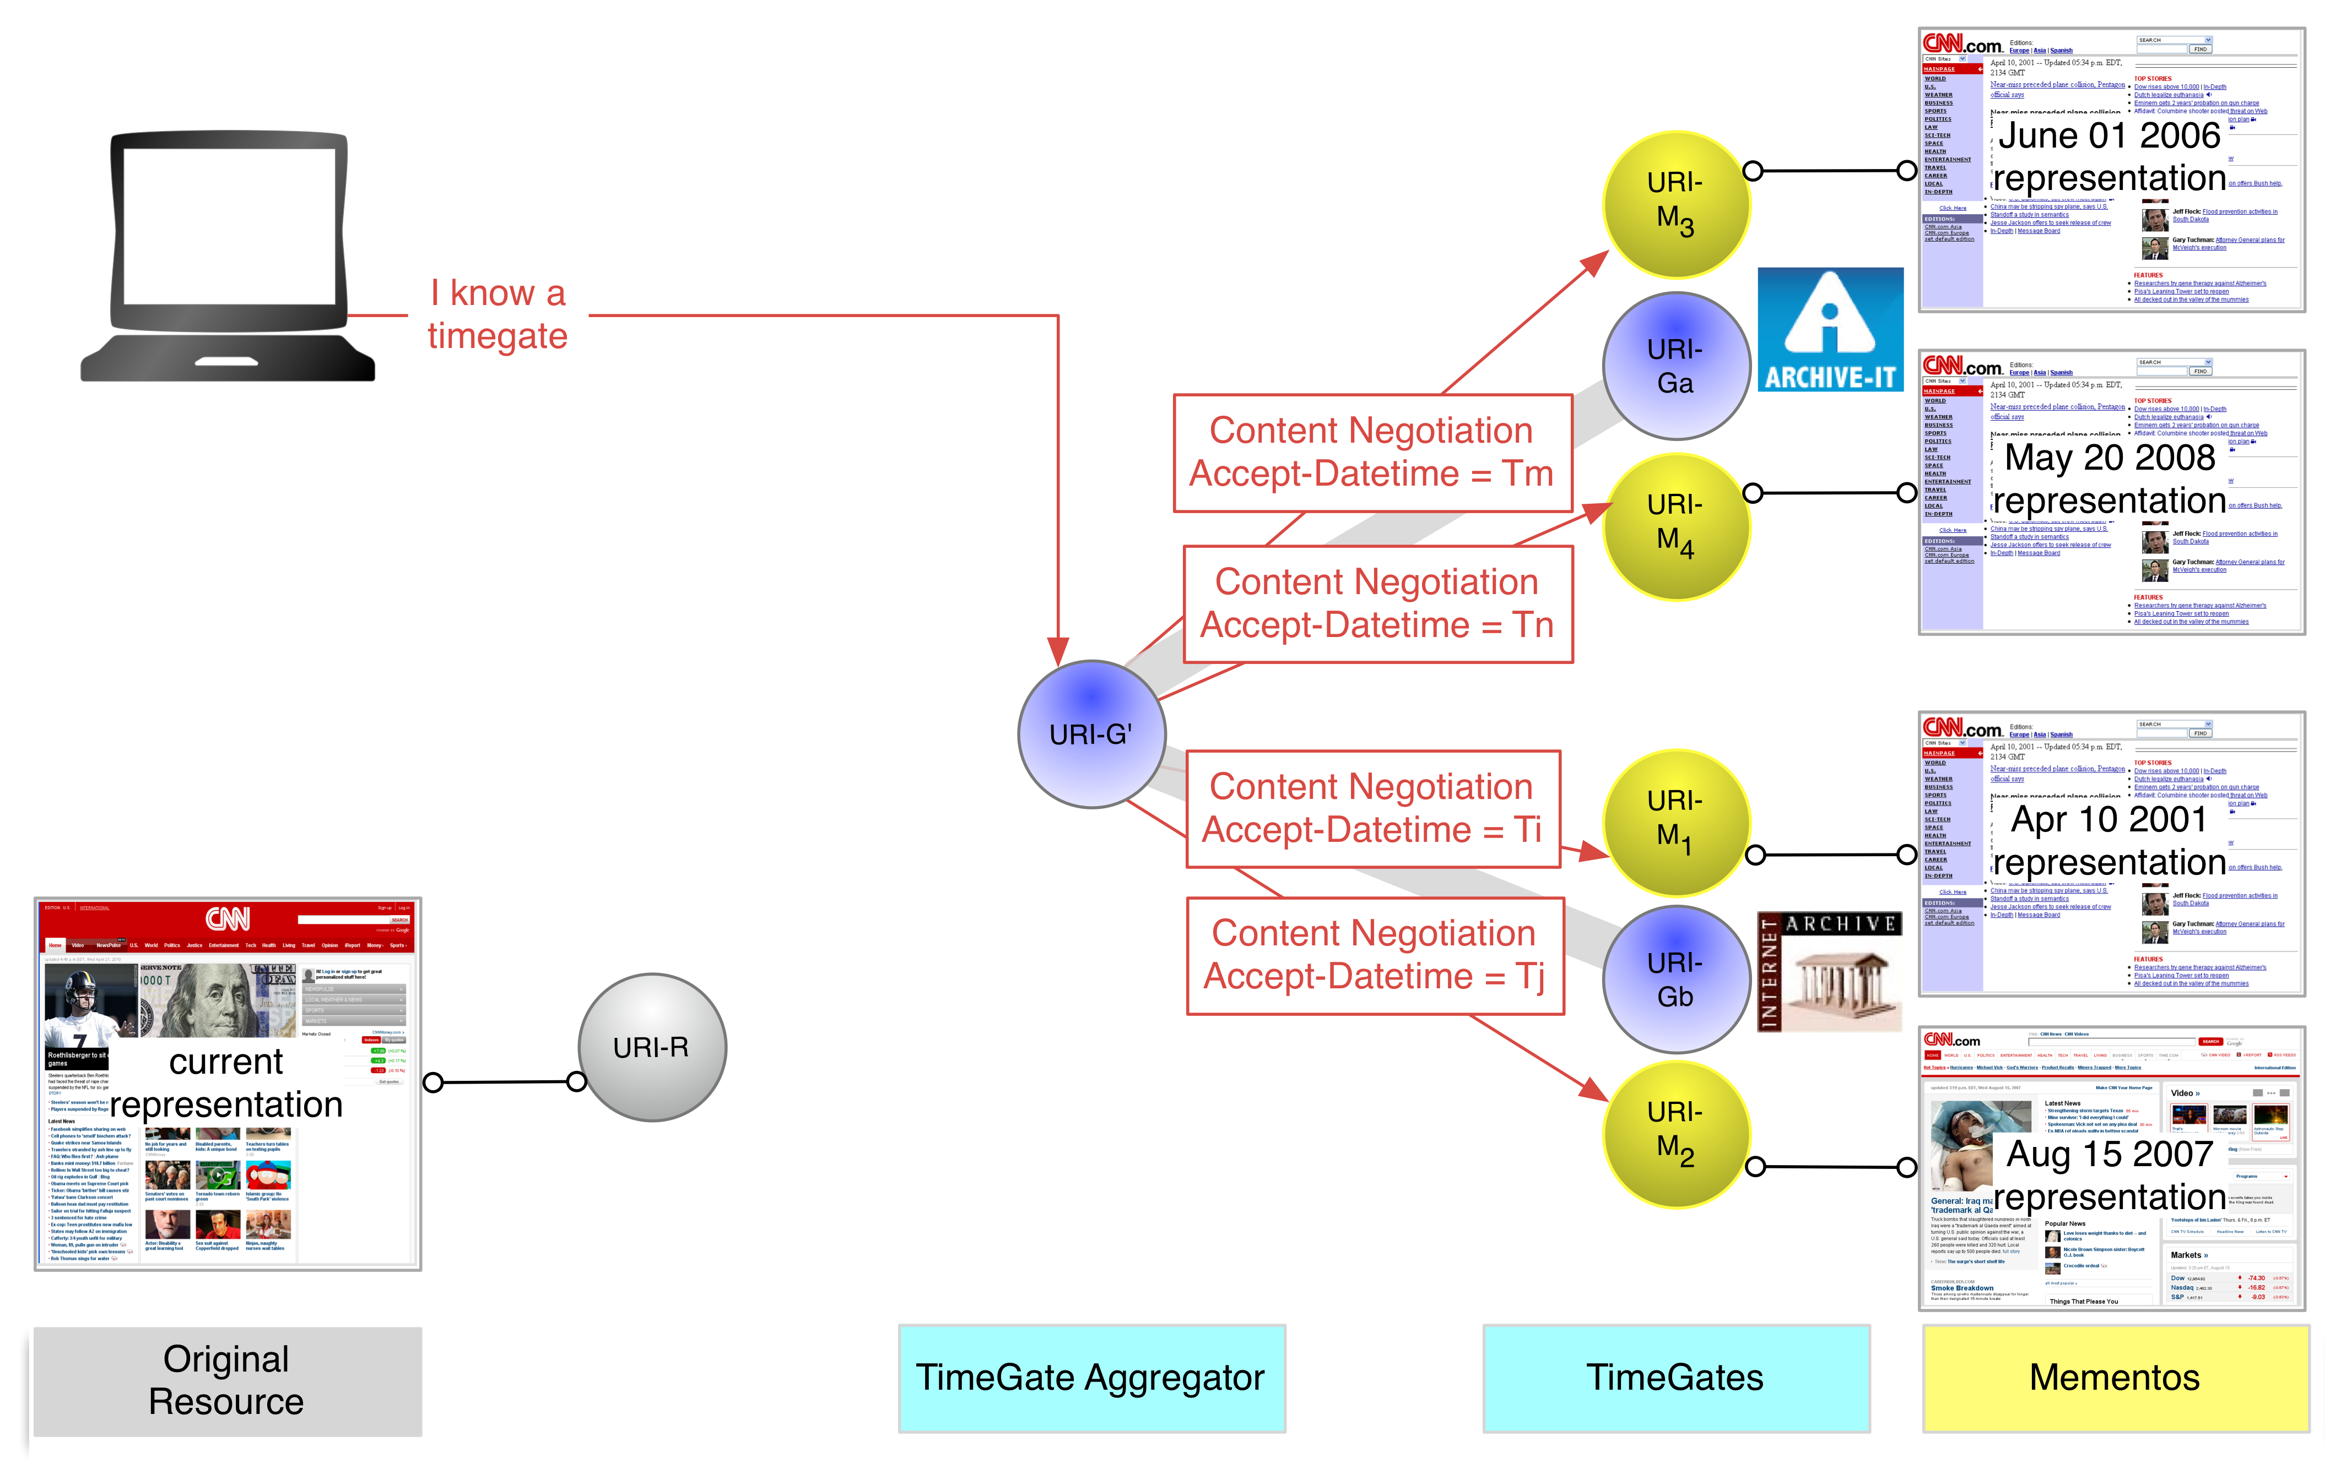
Memento Aggregator
41

Slide 42
TimeGates
A list of TimeGates provided by major web archives as well as
by-proxy TimeGates provided for other systems is maintained at
http://mementoweb.org/depot/
42

Slide 43
Aggregator TimeGate
http://timetravel.mementoweb.org/timegate/original-url
http://timetravel.mementoweb.org/api/#timegate
43

Slide 44
The Memento Framework: Protocol to Integrate Present and Past Web TimeMaps
44

Slide 45
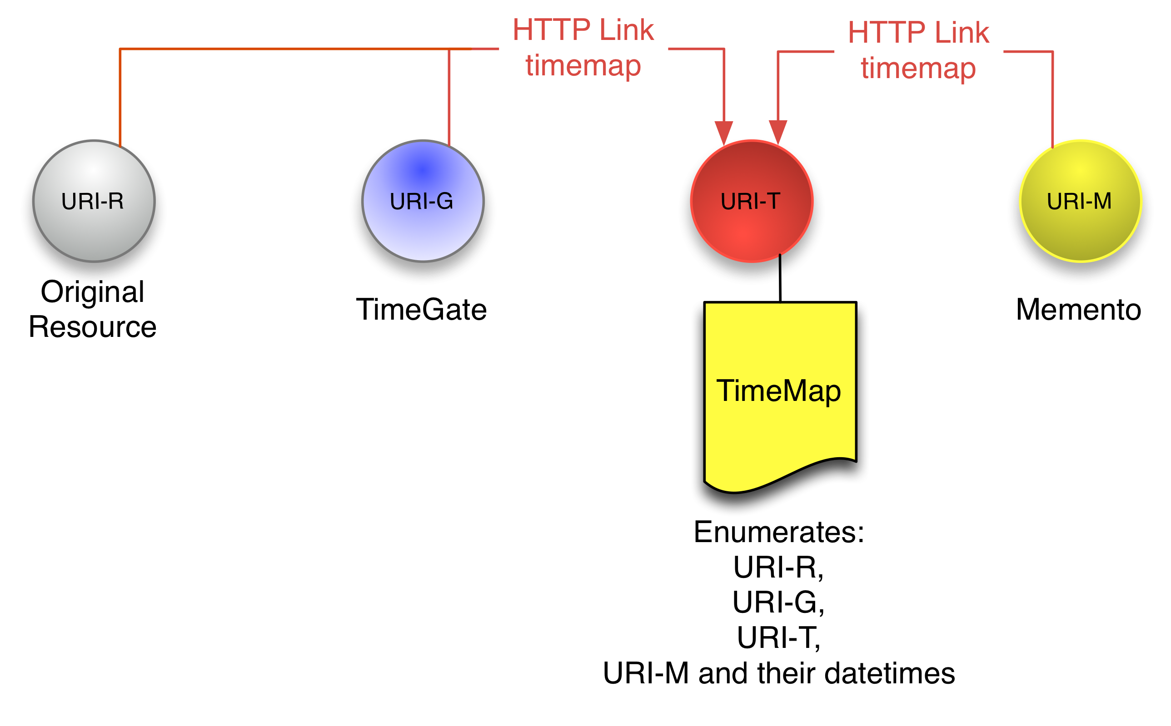
TimeMap
multiple TimeMap serializations possible
application-link/format mandatory
When TimeMaps become too large, they can be broken up and paged or indexed
Aggregator:
Supports JSON TimeMaps
Provides Index TimeMaps
45

Slide 46
Aggregator TimeMaps
http://timetravel.mementoweb.org/timemap/link/original-url
http://timetravel.mementoweb.org/timemap/json/original-url
http://timetravel.mementoweb.org/api/#timemap
46

Slide 47
The Memento Framework: Protocol to Integrate Present and Past Web HTTP Headers
47

Slide 48
The HTTP Headers used in the Memento Protocol
Define two new headers:
request: Accept-Datetime:
response: Memento-Datetime:
Introduce new content for two existing headers:
response: Vary: ; Link:
Use one existing header without modification:
response: Location:, TCN:

Slide 49
HTTP Request Headers for Datetime Negotiation
Accept-Datetime:
Issued against TimeGate, [Original Resource, Memento]
Header value: desired datetime of a Memento
Accept-Datetime: Mon, 12 Oct 2009 14:20:33 GMT

Slide 50
HTTP Response Headers for Datetime Negotiation
Memento-Datetime:
Returned by Mementos only
Even when not as a result of datetetime negotiation
Header value: Archival datetime of the Memento
Resource has not and will not change beyond that date
This header is sticky:
Once returned, a server must always return it with same value
Must also be preserved when Mementos are mirrored at different URIs
This header is crucial to allow a client to understand it has arrived at a Memento
Memento-Datetime: Mon, 12 Oct 2009 14:20:33 GMT

Slide 51
HTTP Response Headers Datetime Negotiation
Vary:
Returned by TimeGate
Similar to regular content negotiation
Header value: accept-datetime
Regular content negotiation (e.g. media type) can be used too but a TimeGate must first meet the datetime preference, and then – if possible – the other content negotiation preferences
Note: accept-datetime in Vary header is crucial to allow a client to understand it has arrived at a TimeGate
Vary: accept-datetime

Slide 52
HTTP Response Headers for Datetime Negotiation
Location:
Returned by TimeGate
Similar to regular content negotiation
Header value: URI of the Memento selected by the TimeGate
Location: http://web.archive.org/web/20010911223004/http://cnn.com

Slide 53
HTTP Response Headers for Datetime Negotiation
Link:
Returned by Original Resource, TimeGate and Mementos
Various new Relation Types are introduced:
“original” – points to Original Resource
“timegate” – points to TimeGate
“memento” – points to Memento
“timemap” – points to TimeMap
A TimeGate must provide the “original” link
A Memento must provide the “original” link
CMS that want to support Memento must provide the “timegate” link
All other links are encouraged but optional
HTTP Link Header: RFC 5988

Slide 54
HTTP Response Headers for Datetime Negotiation
Link:
The following ”memento” links that point at special Mementos, known to the responding server, are optional but very useful:
First and last Memento known to the server, e.g. ”memento first”
Memento prior and after the selected Memento, e.g. “”memento predecessor-version”
Selected Memento
Temporal order of Mementos is expressed using existing relation types from RFC 5829 and RFC 5988: first, last, next, prev, successor-version, predecessor-version

Slide 55
HTTP Response Headers for Datetime Negotiation
Link:
Attributes for a ”memento” Link:
datetime (mandatory): datetime of the Memento pointed at by the link
license (optional): license associated with the Memento
Attributes for a ”timemap” Link:
type (recommended): MIME type of TimeMap serialization
from, until (optional): to convey the temporal interval of Memento datetimes covered by the TimeMap

Slide 56
Memento Datetime Negotiation - HTTP Flow
HEAD R, [Accept-Datetime]
[Link ➔ G]
[timegate]
HEAD G, Accept-Datetime
302 ➔ M, Vary, Link ➔ R [M T]
original [memento timemap]
GET M, [Accept-Datetime]
200, Memento-Datetime, Link ➔ R [G M T]
original [timegate memento timemap]

Slide 57
The Memento Framework: Protocol to Integrate Present and Past Web HTTP Interactions
57

Slide 58
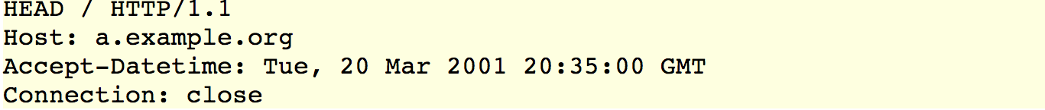
Datetime Negotiation Flow: Step 1
58

Slide 59
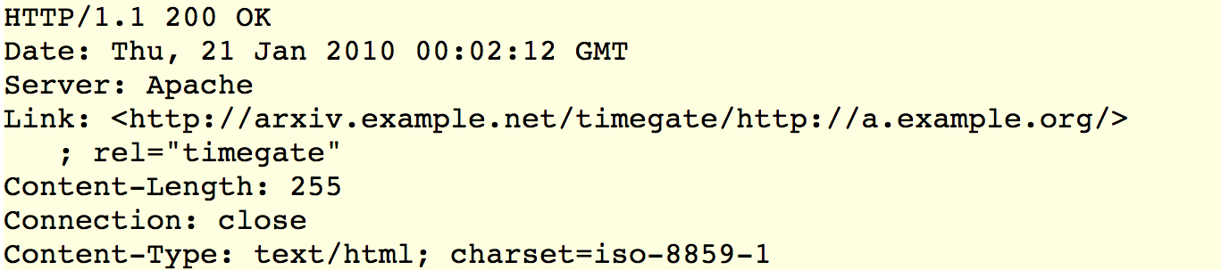
Datetime Negotiation Flow: Step 2
59

Slide 60
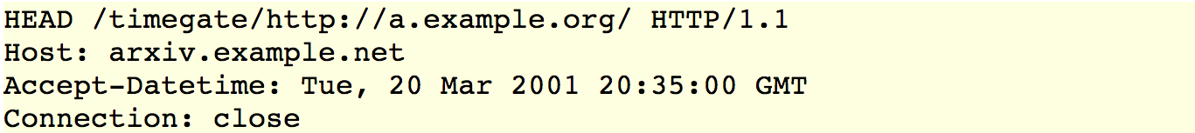
Datetime Negotiation Flow: Step 3
60

Slide 61
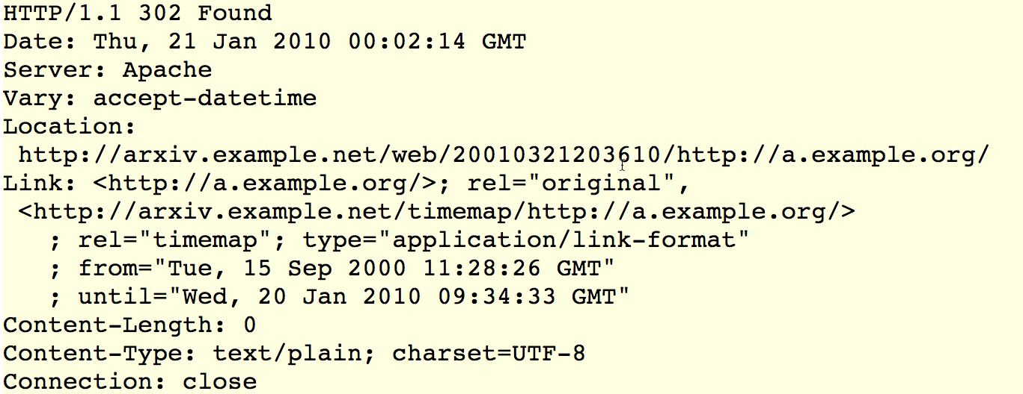
Datetime Negotiation Flow: Step 4
61

Slide 62
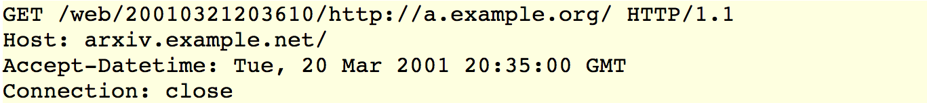
Datetime Negotiation Flow: Step 5
62

Slide 63
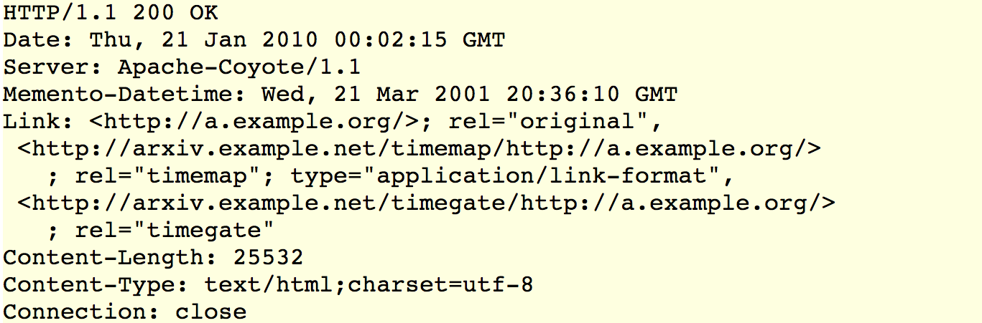
Datetime Negotiation Flow: Step 6
63

Slide 64
TimeMap Access Flow: Step 1
64

Slide 65
TimeMap Access Flow: Step 2
65

Slide 66
TimeMap Access Flow: Step 3
66

Slide 67
TimeMap Access Flow: Step 4
67

Slide 68

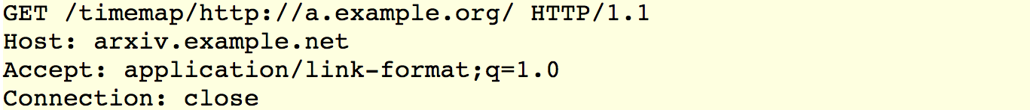
TimeMap Access Flow: Step 5
68

Slide 69
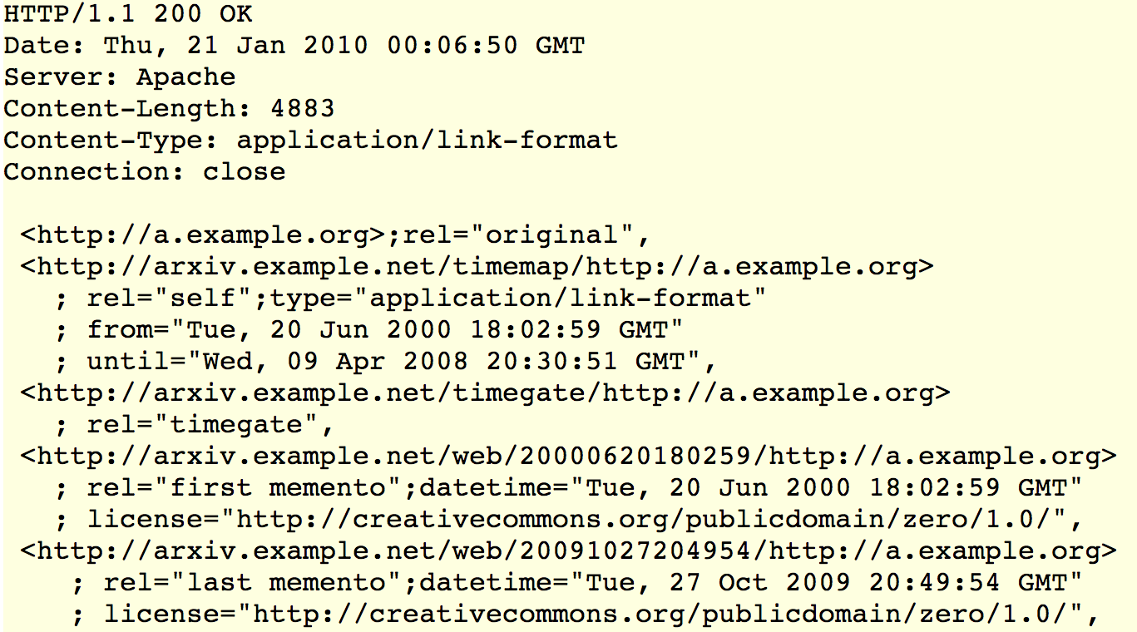
TimeMap Access Flow: Step 6
69

Slide 70
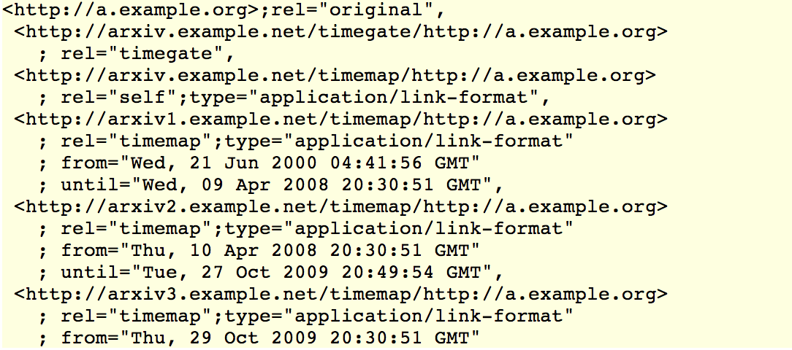
TimeMap Access Flow: Step 6 with Index TimeMap
70

Slide 71
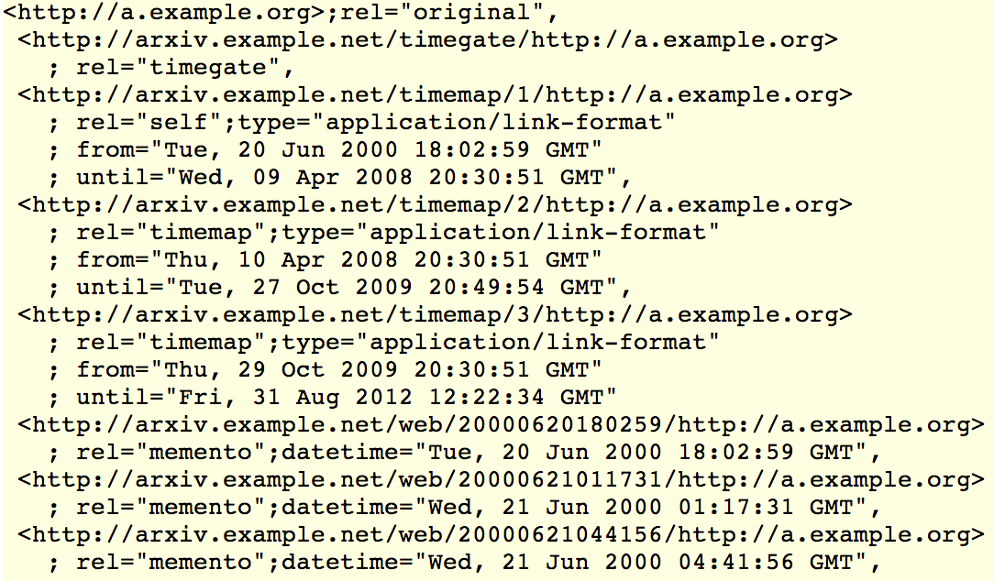
TimeMap Access Flow: Step 6 with Paging TimeMap
71

Slide 72
The Memento Framework: Protocol to Integrate Present and Past Web Resource Versioning and Memento
72

Slide 73
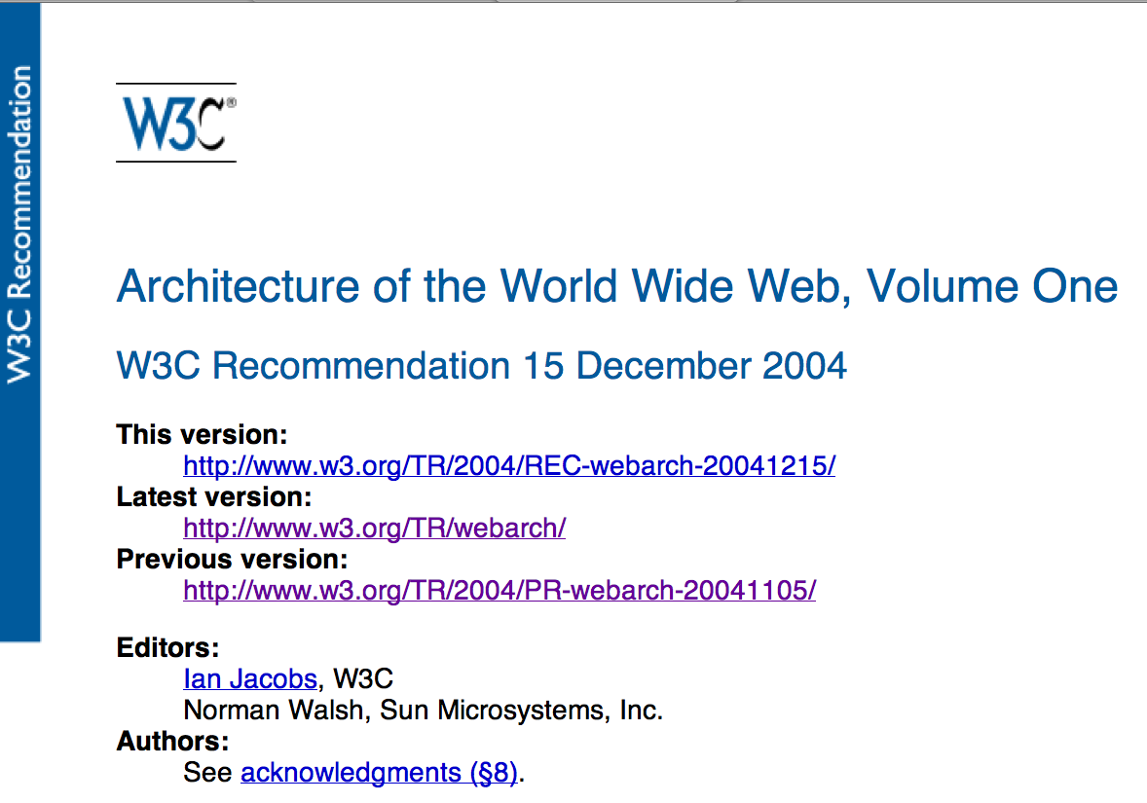
Common Resource Versioning Approach
Notes:
Pattern exists in e.g.: WikiPedia, W3C specs, Dryad
Not sure whether DOI in general follows this paradigm.

Slide 74
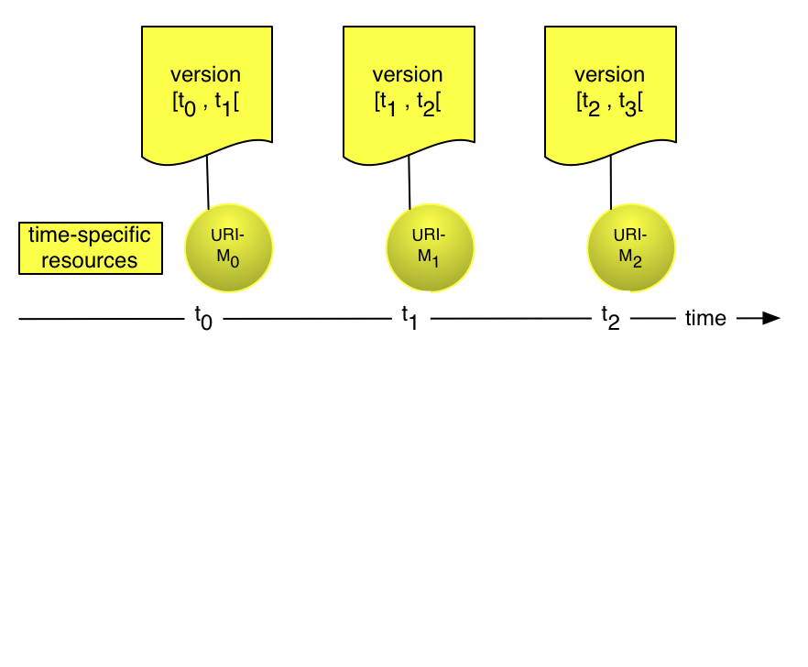
Version Resources
(*)
(*) Tim Berners-Lee (1996) http://www.w3.org/DesignIssues/Generic.html

Slide 75
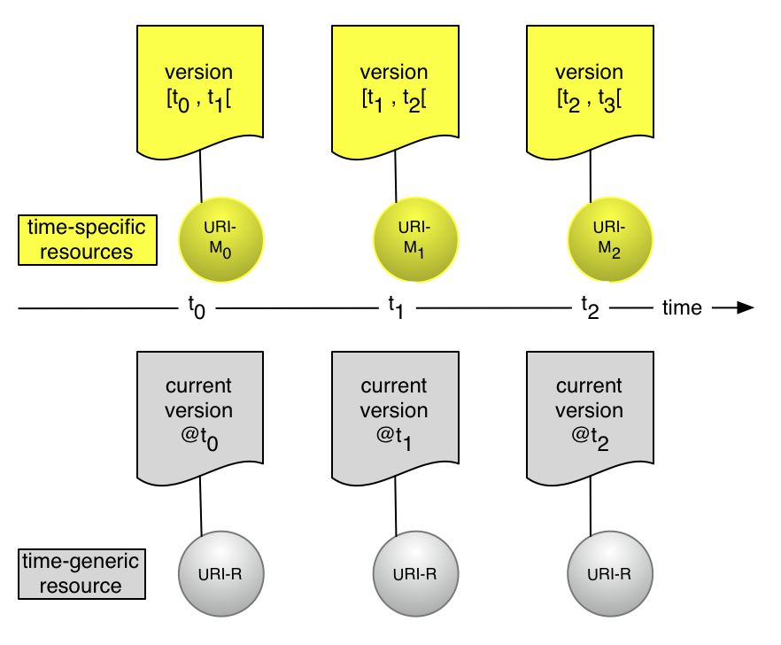
Version Resources and Associated Generic Resource
(*)
(*)
(*) Tim Berners-Lee (1996) http://www.w3.org/DesignIssues/Generic.html

Slide 76
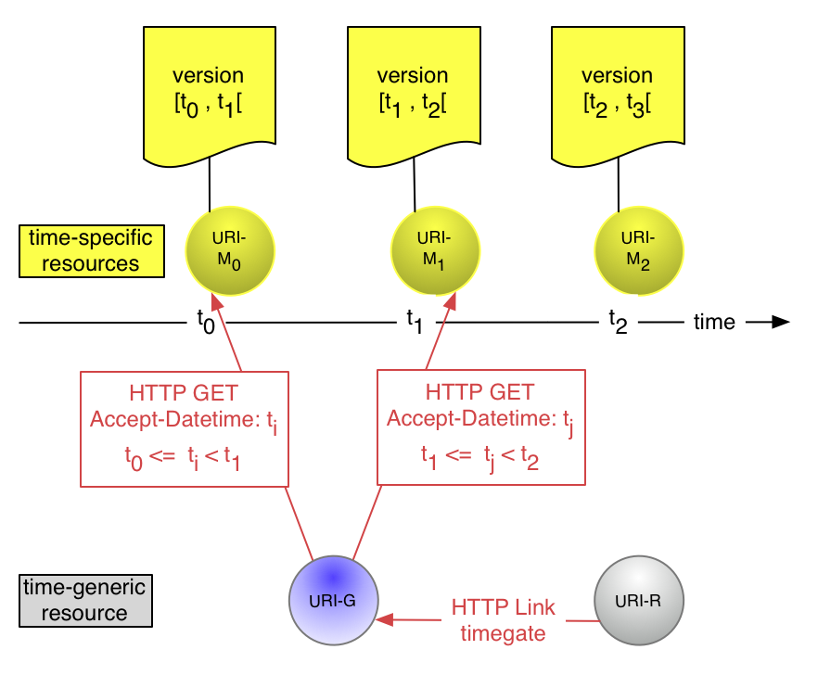
Memento Bridges Between Generic & Specific Resources

Slide 77
Stepwise Support for the Memento Protocol – Step 1
Provide Memento protocol HTTP response headers to convey version date and links
Provide Memento-Datetime header to express version date
Provide Link header with “original” link to point from version resource to generic resource
Provide Link header with appropriate “memento” links to allow navigating between versions
In combination with links with other relation types, e.g. “first”, “last”, “prev”, “next”, “predecessor-version”, “successor-version”

Slide 78
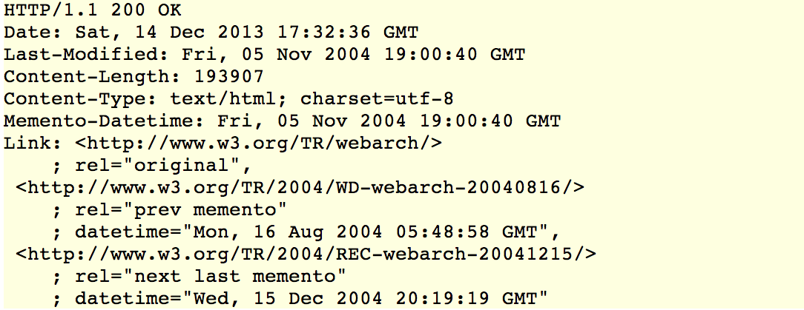
Stepwise Support for the Memento Protocol – Step 1
Response to HTTP HEAD/GET against
http://www.w3.org/TR/2004/PR-webarch-20041105/

Slide 79
Stepwise Support for the Memento Protocol – Step 2
Publish a TimeMap, at, say, http://www.w3.org/TR/timemap/webarch/
For the generic resource and for each version resource, provide a Link header with “timemap” link that points at the TimeMap

Slide 80
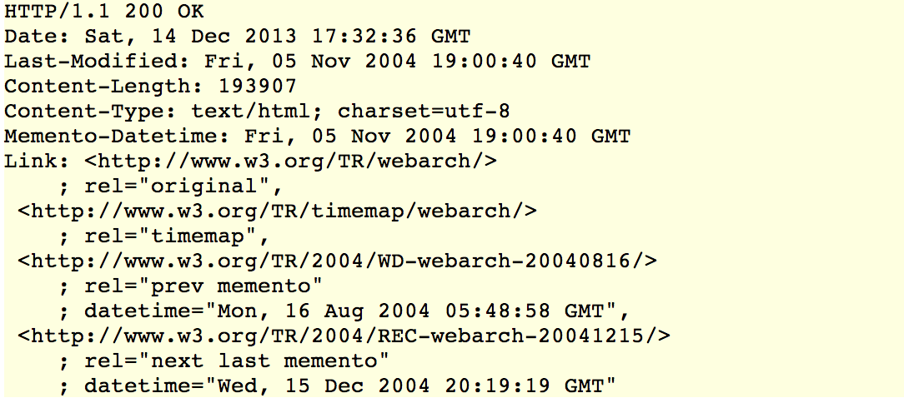
Stepwise Support for the Memento Protocol – Step 2
Response to HTTP HEAD/GET against
http://www.w3.org/TR/2004/PR-webarch-20041105/

Slide 81
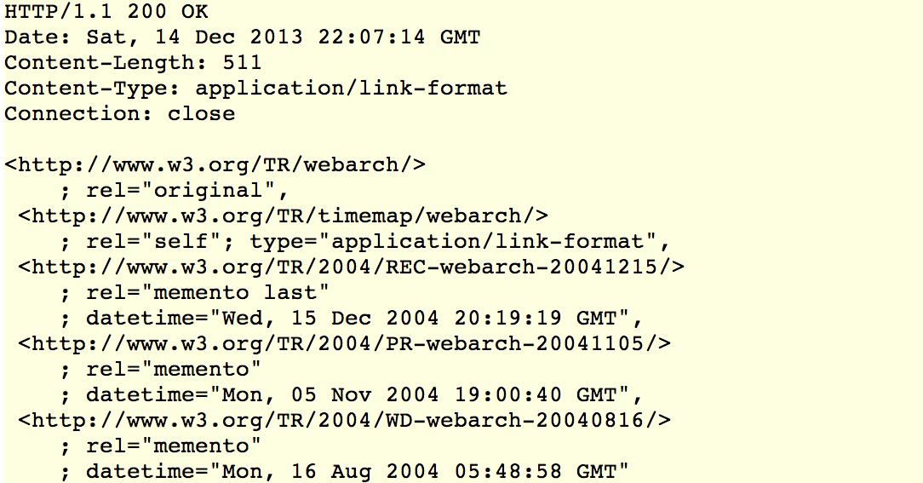
Stepwise Support for the Memento Protocol – Step 2
Response to HTTP GET against
http://www.w3.org/TR/timemap/webarch/

Slide 82
Stepwise Support for the Memento Protocol – Step 3
Expose a TimeGate, at, say, http://www.w3.org/TR/timegate/webarch/
Reponses for generic resource, version resources, TimeGate, TimeMap as shown in slides 56-70
Note that Patterns for datetime negotiation other than the one shown in those slides are described in RFC 7089

Slide 83
The Memento Framework: Protocol to Integrate Present and Past Web Memento and Linked Data
83

Slide 84


Slide 85


Slide 86
The Memento Framework: Protocol to Integrate Present and Past Web Additional Details
86

Slide 87
Fixed Resource
The resource is its own Memento, i.e. it is a stable resource
Resource that was born stable or became stable; it will not change anymore, e.g. PermaLink resources on news sites
Resource provides:
Link header with ”original” link pointing to itself
Memento-Datetime header
Note the difference with Last-Modified header: no promise resource will not change anymore
Details at http://ws-dl.blogspot.com/2010/11/2010-11-05-memento-datetime-is-not-last.html

Slide 88

Fixed Resource
Response to HTTP HEAD/GET against
http://a.example.org

Slide 89
Memento Without TimeGate
The resource is a Memento but there is no TimeGate available for it
e.g. snapshot of resource when server is being retired
Resource provides:
Link header with ”original” link revealing the URI of Original Resource
Memento-Datetime header

Slide 90

Memento Without TimeGate
Response to HTTP HEAD/GET against
http://arxiv.example.net/web/20010321203610/http://a.example.org

Slide 91
Intermediate Resource
The resource issues a redirect to a TimeGate, a Memento, another intermediate resource
Plays an active role in the Memento framework
Resource provides:
Link header with ”original” link revealing the URI of Original Resource

Slide 92

Intermediate Resource
Response to HTTP HEAD/GET against a resource that redirects to a TimeGate

Slide 93
Resource Excluded from Datetime Negotiation
e.g. JavaScript, logos, banners added by web archives
Resource always needs to be used in its current state
In order to flag it is excluded from datetime negotiation, this resource provides:
Link header with ”type” link that has as value
http://mementoweb.org/terms/donotnegotiate

Slide 94

Resource Excluded from Datetime Negotiation
Response to HTTP HEAD/GET against a resource that is excluded from datetime negotiation

Slide 95
Memento of a Redirect
HTTP responses with 3XX codes are also archived
e.g. web archives hold on to “301 Moved Permanently” and “302 Found” whereas Linked data archives preserve “303 See Other”
The Memento’s response must have the same HTTP status code as the original
Memento headers are as usual
Memento clients need to understand that the redirect (URI in Location header) can be to an Original Resource or to a Memento
If an Original Resource, the client must proceed to find an appropriate Memento for it

Slide 96

Memento of a Redirect
Response in April 2008 to HTTP HEAD/GET against
http://a.example.org

Slide 97

Memento of a Redirect
Response to a HTTP HEAD/GET of a Memento of that 2008 redirect, whereby the redirect is unchanged, i.e. it is to the resource to which the redirect originally led

Slide 98

Memento of a Redirect
Response to a HTTP HEAD/GET of a Memento of that 2008 redirect, whereby the redirect is rewritten, i.e. it leads to a Memento of the resource to which the redirect originally led

Slide 99
The Memento Framework: Protocol to Integrate Present and Past Web Memento RESTful API
99

Slide 100
Memento API – Redirect to Temporally Best Memento
http://timetravel.mementoweb.org/memento/2013/https://github.com/mementoweb/SiteStory
http://timetravel.mementoweb.org/memento/20130115102033/https://github.com/mementoweb/SiteStory
HTTP/1.1 302 Found
Date: Sun, 8 Mar 2015 20:44:44 GMT
Content-Type: text/plain; charset=iso-8859-1
Content-Length: 0
Location: http://en.wikipedia.org/w/index.php?title=Web_archiving&amp;oldid=526371727
http://timetravel.mementoweb.org/api/#memento-redirect

Slide 101
Memento API – JSON Info About Temporally Best Memento
http://timetravel.mementoweb.org/api/json/2013/https://github.com/mementoweb/SiteStory
http://timetravel.mementoweb.org/api/json/20130115102033/https://github.com/mementoweb/SiteStory
{
"original_uri": "http://www.cnn.com/",
"mementos": {
"closest": {
"datetime": "2013-01-15T09:46:43Z",
"uri": [ "http://archive.today/aaqIY"
]
}, …
http://timetravel.mementoweb.org/api/#memento-json

Slide 102
The Memento Framework: Protocol to Integrate Present and Past Web Robust Links to Alleviate Link Rot and Content Drift
102

Slide 103
Pockets of Persistence
How to achieve the ability to:
Persistently
Precisely
Seamlessly
revisit the Web of the Past and the Web of the Now at some point in the Future
Two components to the link/reference rot challenge:
Link rot: Links stop working aka 404 Not Found
Content drift: Referenced content changes over time

Slide 104

Illustration
Current version of http://en.wikipedia.org/wiki/Coil_(band) on October 22 2014

Slide 105

Illustration – Link Rot
Current version of http://en.wikipedia.org/wiki/Coil_(band) on October 22 2014

Slide 106

Illustration – Link Rot
Current version of http://liarsociety.tripod.com/blog/index.blog?from=20041130 on October 22 2014

Slide 107


Illustration – Content Drift
Version of http://en.wikipedia.org/wiki/Coil_(band) dated October 2 2014
http://en.wikipedia.org/w/index.php?title=Coil_(band)&oldid=388321480

Slide 108

Illustration – Content Drift
Current version of http://en.wikipedia.org/wiki/Peter_Christopherson on October 22 2014

Slide 109

Illustration – Content Drift
Version of http://en.wikipedia.org/wiki/Peter_Christopherson that was current on October 2 2010
http://en.wikipedia.org/w/index.php?title=Peter_Christopherson&oldid=387987414

Slide 110
Pockets of Persistence
How to achieve the ability to:
Persistently
Precisely
Seamlessly
revisit the Web of the Past and the Web of the Now at some point in the Future
This challenge exists for the entire web, but some communities actually care about addressing it:
scholarly communication,
legal publications,
journalism,
Wikipedia,
…

Slide 111
Addressing the Link/Reference Rot Challenge
Capture – Archive Pro-Actively
On-demand archiving functionality provided by:
archive.today
Perma.cc
Internet Arcxhive

Slide 112
Addressing the Link/Reference Rot Challenge
Reference Captures – Decorate Links

Slide 113
Reference Captures by Decorating Links
Van de Sompel, H. et al. (2013) Thoughts on referencing, linking, reference rot
http://mementoweb.org/missing-link/
Existing practice for linking to captures:
Link to URI of Capture
Lose Original URI
Lose Capture Datetime
Problems with existing practice:
Impossible to visit the original URI, if desired
Requires the permanent existence/uptime of the archive that holds the capture
One link rot problem replaced by another

Slide 114
Hacking Original URI, Capture Datetime from Capture URI?
URI of Capture | Original URI | Datetime T
https://web.archive.org/web/20140214233752/https://www.mummify.it | yes | yes
https://archive.today/eAETp | no | no
http://perma.cc/4RH7-999Q?type=source | no | no
http://en.wikipedia.org/w/index.php?title=Coil_(band)&oldid=388321480 | no | no

Slide 115

Using Capture URI to find Captures in Other Web Archives?

Slide 116

Using Capture URI to find Captures in Other Web Archives?

Slide 117
Reference Captures by Decorating Links
http://robustlinkls.mementoweb.org/motivation/
Desired practice for linking to captures is to annotate the link so it conveys:
URI of Capture
Original URI
Capture Datetime
Link decoration supports fallback to other archives:
Original URI allows finding captures in all web archives
Capture Datetime allows finding an appropriate capture in all web archives
Original URI and Capture Datetime allows automatic access to an appropriate capture in all web archives (see Access)

Slide 118
Link Decoration Proposal using HTML5 data- attributes
Augment a link with information that increases robustness:
URI-R – the key in all archives
URI-M - the specific version resource intended by the link
Link date – to indicate the state of URI-R intended by the link
Current implementation - Uses HTML5 extension mechanism that allows for data- attributes:
data-originalurl – for URI-R
data-versionurl – for URI-M
data-versiondate – for the date
http://robustlinks.mementoweb.org/spec/

Slide 119
Link Decoration Proposal using HTML5 data- attributes
<a href=“http://dl00.org”>
<a href=http://dl00.org
data-versiondate=“2000-06-21T20:00:00Z”>
<a href=http://dl00.org
data-versiondate=“2000-06-21T20:00:00Z”
data-versionurl=“http://web.archive.org/20060621183421/http://www.dl00.org”>
http://robustlinks.mementoweb.org/spec/

Slide 120
Link Decoration Proposal using HTML5 data- attributes
<a href=“http://web.archive.org/20060621183421/http://www.dl00.org”>
<a href=“http://web.archive.org/20060621183421/http://www.dl00.org”
data-originalurl=“http://dl00.org”>
<a href=“http://dl00.org”
data-originalurl=“http://dl00.org”
data-versiondate=“2000-06-21T20:00:00Z”>

Slide 121
But What if I Didn’t Make a Capture???
Introduce page date from schema.org itemprop=“datePublished”
Suddenly all old links can be dereferenced subject to time using Memento infrastructure
With browser extension (Memento for Chrome) using HTTP datetime negotiation
Without browser extension, only JavaScript, using the Memento Aggregator API
http://robustlinks.mementoweb.org/demo/

Slide 122
The Memento Framework: Protocol to Integrate Present and Past Web Pointers
122

Slide 123
Pointers
RFC 7089 - http://tools.ietf.org/html/rfc7089 (text version), http://www.mementoweb.org/guide/rfc/ (HTML version)
Memento Aggregator APIs http://timetravel.mementoweb.org/guide/api/
Robust Links spec http://robustlinks.mementoweb.org/spec/
Memento GitHub projects - https://github.com/mementoweb/
Information on TimeGates and TimeMaps for major systems - http://mementoweb.org/depot/
Client and Server software and tools - http://mementoweb.org/tools/
Memento Development List - http://groups.google.com/group/memento-dev/

Slide 124


Experience and Enable Time Travel
http://bit.ly/memento-for-chrome
http://bit.ly/memento-for-mediawiki

Slide 125
Memento: Time Travel for the Web
Overview of RFC 7089
http://mementoweb.org/
Memento has received funding from
The Library of Congress
Andrew W. Mellon Foundation
IIPC
125

